Slide 1

Linear Regression
AP Statistics – Chapter 8
We use actual values for “x”…
so no hat here.
$$\hat{y}=b_{0}+b_{1}x$$
We are predicting the y-values, thus the “hat” over the “y”.
slope
y-intercept

Slide 2
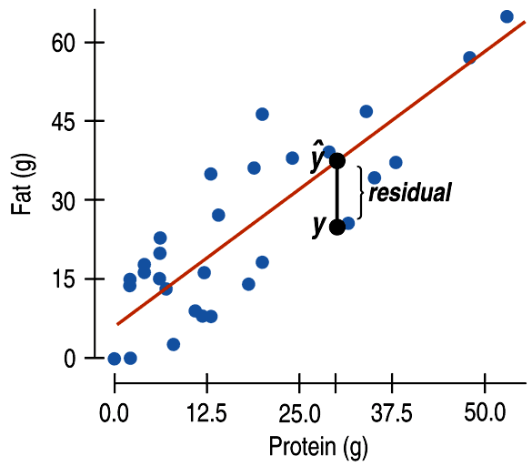


Residuals
(difference between observed value and predicted value)
Believe it or not, our “best fit line” will actually MISS most of the points.
Residual:
Observed y – Predicted y
$$e=y−\hat{y}$$

Slide 3
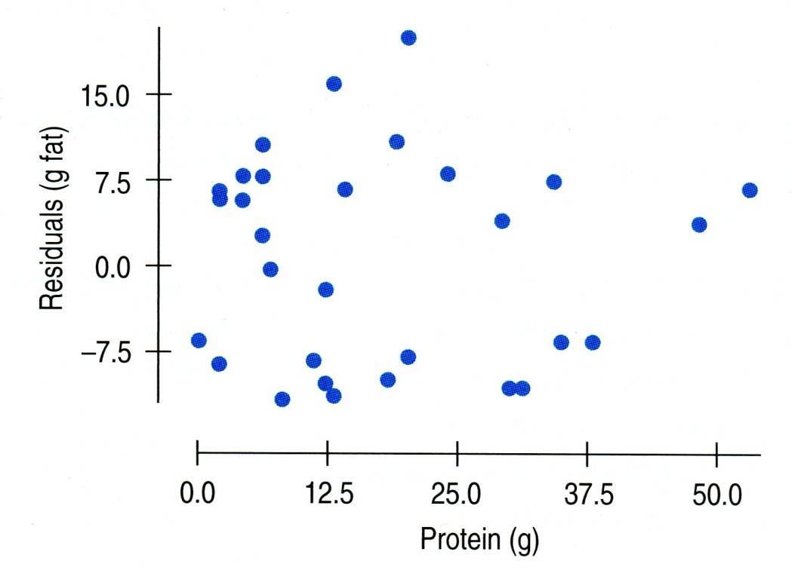
Every point has a residual...
and if we plot them all, we have a residual plot.
We do NOT want a pattern in the residual plot!
This residual plot has
no distinct pattern…
so it looks like a linear model is appropriate.

Slide 4
Is a linear model appropriate?
A residual plot that has no distinct pattern is an indication that a linear model might be appropriate.
Linear
Not linear

Slide 5
Least Squares Regression Line
is the line (model) which minimizes the sum of the squared residuals.

Slide 6
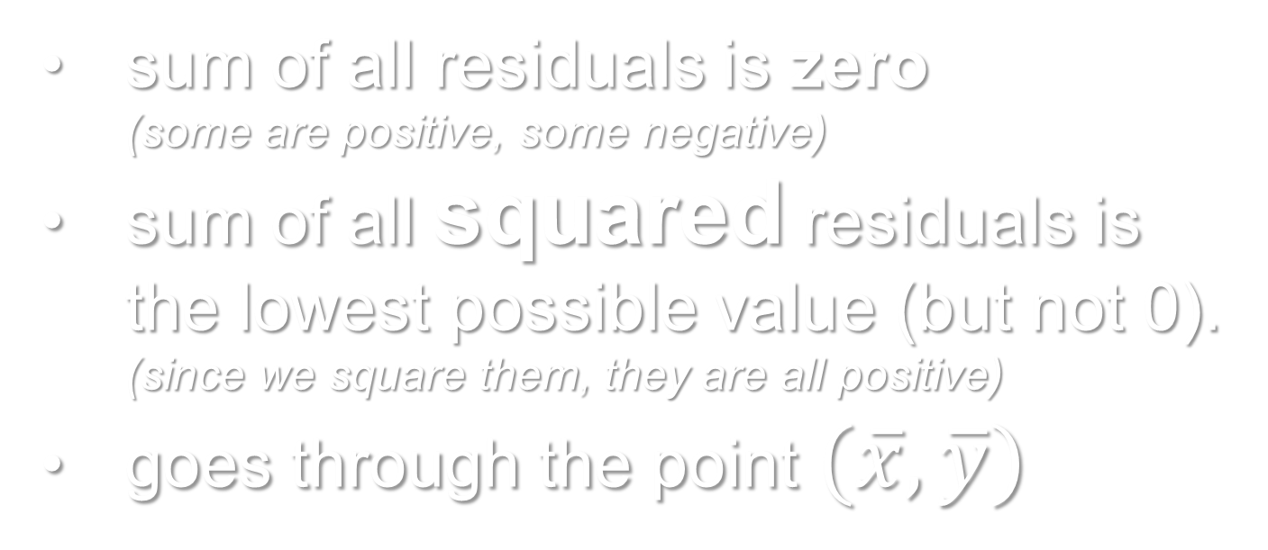
Facts about LSRL
sum of all residuals is zero
(some are positive, some negative)
sum of all squared residuals is the lowest possible value (but not 0).
(since we square them, they are all positive)
goes through the point $(\overline{x}, \overline{y})$
[shut down the laptops, but don’t put them back yet…]

Slide 7
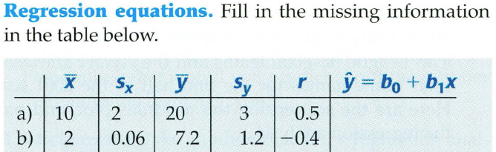
Building the regression equation…

Slide 8
Outliers, leverage, and influence
If a point’s x-value is far from the mean of the x-values, it is said to have high leverage.
(it has the potential to change the regression line significantly)
A point is considered influential if omitting it gives a very different model.

Slide 9
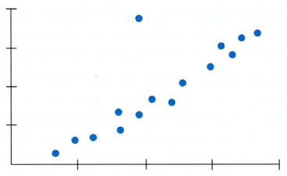
Outlier or Influential point? (or neither?)
outlier

Slide 10
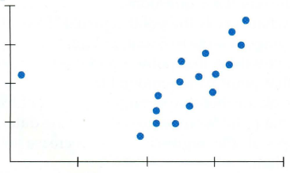
Outlier or Influential point? (or neither?)
influential point

Slide 11
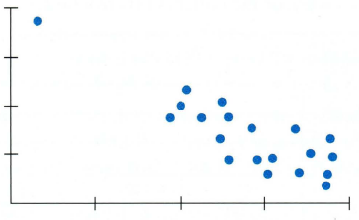
Outlier or Influential point? (or neither?)
Although this point has high leverage, deleting it would NOT change the slope drastically.
neither

