Slide 1
about BIAS…

Slide 2
Bias
A systematic error in measuring the estimate
favors certain outcomes
Anything that causes the data to be wrong! It might be attributed to the researchers, the respondent, or to the sampling method!

Slide 3
Sources of Bias
Garbage in…. Garbage out!
things that can cause bias in your sample
cannot do anything with bad data

Slide 4
Voluntary response
People chose to respond
Usually only people with very strong opinions respond
Remember – the way to determine voluntary response is:
Self-selection!!

Slide 5

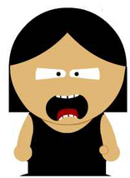


Convenience sampling
The data obtained by a convenience sample will be biased – however this method is often used for surveys & results reported in newspapers and magazines!
Ask people who are easy to ask
An example would be stopping friendly-looking people in the mall to survey. Another example is the surveys left on tables at restaurants - a convenient method!

Slide 6
Undercoverage
Suppose you take a sample by randomly selecting names from the phone book – some groups will not have the opportunity of being selected!
some groups of population are left out of the sampling process

Slide 7
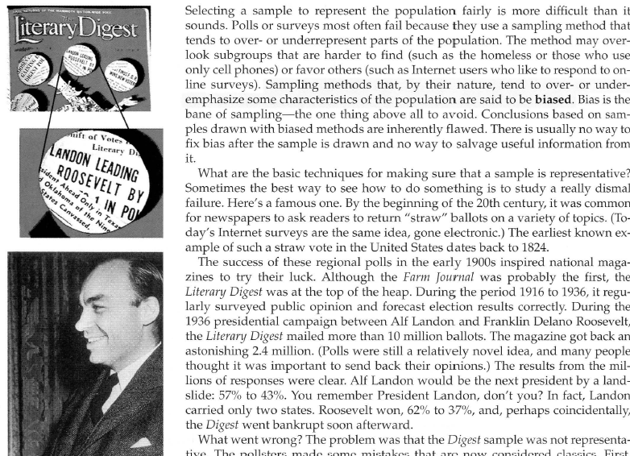

Slide 8
Nonresponse
People are chosen by the researchers, BUT refuse to participate.
NOT self-selected!
This is often confused with voluntary response!
occurs when an individual chosen for the sample can’t be contacted or refuses to cooperate
telephone surveys 70% nonresponse

Slide 9
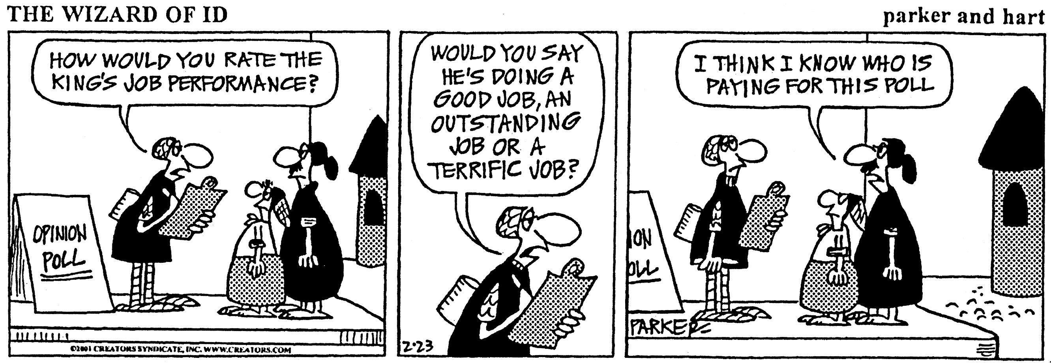
Response Bias
  anything in the survey design that influences the responses
  Interviewer bias/intimidation
  Untruthful responses
  The wording of a question

Slide 10
(examples of response bias)
A uniformed campus police office visits your class and asks every student about their drug use in the last 30 days…
In 2011, Leander ISD was forced to cut a number of jobs due to budget cuts. As part of their exit surveys, they asked teachers the following question:
“Would you recommend Leander ISD to a friend as a good place to work?”

Slide 11
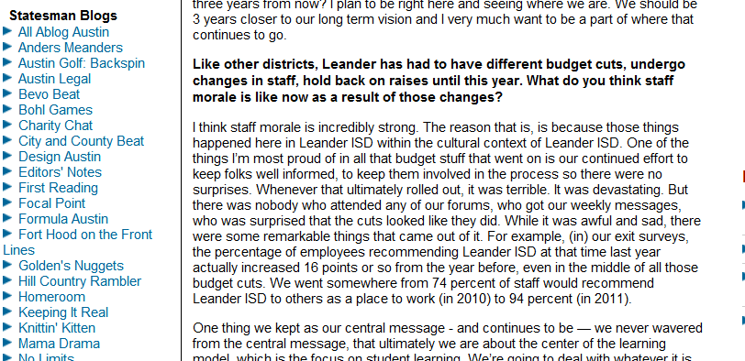
“We went somewhere from 74 percent of staff would recommend Leander ISD to others as a place to work (in 2010) to 94 percent (in 2011).”

Slide 12
Bias through wording of a question

Slide 13
Subtle differences in phrasing can make a big difference
In January 2006, the New York Times asked half of the 1229 U.S. adults in their sample the following question:
After 9/11, President Bush authorized government wiretaps on some phone calls in the U.S. without getting court warrants, saying this was necessary to reduce the threat of terrorism. Do you approve or disapprove of this?
53% of respondents approved.

Slide 14
subtle differences in phrasing can make a big difference!
…but when they asked the other half of their sample a question with only slightly different wording:
After 9/11, George W. Bush authorized government wiretaps on some phone calls in the U.S. without getting court warrants. Do you approve or disapprove of this?
…only 46% approved

Slide 15
subtle differences in phrasing can make a big difference!
After 9/11, President Bush authorized government wiretaps on some phone calls in the U.S. without getting court warrants, saying this was necessary to reduce the threat of terrorism. Do you approve or disapprove of this?
After 9/11, George W. Bush authorized government wiretaps on some phone calls in the U.S. without getting court warrants. Do you approve or disapprove of this?

Slide 16
BIAS through wording of question
Spring, 1993, Holocaust Memorial Museum opened in Washington, DC.
Survey conducted by Roper Starch Worldwide indicated that 22 percent of the American public believed it “possible that the Nazi extermination of the Jews never happened”, while another 12 percent were unsure.

Slide 17
Exact wording of the Roper question:
Does it seem possible, or does it seem impossible to you that the Nazi extermination of the Jews never happened?
Gallup question in a new poll:
Does it seem possible to you that the Nazi extermination of the Jews never happened, or do you feel certain that it happened?
…less than 1% responded that they thought it was possible it did not happen

Slide 18
Source of Bias?
1) Before the presidential election of 1936, FDR against Republican ALF Landon, the magazine Literary Digest predicting Landon winning the election in a 3-to-2 victory. A survey of 2.8 million people. George Gallup surveyed only 50,000 people and predicted that Roosevelt would win. The Digest’s survey came from magazine subscribers, car owners, telephone directories, etc.
Undercoverage – since the Digest’s survey comes from car owners, etc., the people selected were mostly from high-income families and thus mostly Republican! (other answers are possible)

Slide 19
2) Suppose that you want to estimate the total amount of money spent by students on textbooks each semester at SMU. You collect register receipts for students as they leave the bookstore during lunch one day.
Convenience sampling – easy way to collect data
or
Undercoverage – students who buy books from on-line bookstores are not included.

Slide 20
3) To find the average value of a home in Austin, one averages the price of homes that are listed for sale with a realtor.
Undercoverage – leaves out homes that are not for sale or homes that are listed with different realtors.
(other answers are possible)

Slide 21
stop!

