Slide 1
Experiments and Observational Studies
chapter 13

Slide 2
OBSERVATIONAL VS. EXPERIMENTAL
observational study
  no treatment is assigned – SELF SELECTION
  merely observe a characteristic
  Prospective vs. Retrospective
    Prospective: Pick subjects, then follow them for some time
    Retrospective: Pick subjects, then look up their past records
experimental study
  a treatment is assigned (hopefully RANDOMLY)
  observe the response and measure its effect

Slide 3
The ONLY way
to show CAUSE & EFFECT is with
a randomized experiment!!!
(RANDOM ASSIGNMENT OF
SUBJECTS TO TREATMENTS!!!)

Slide 4
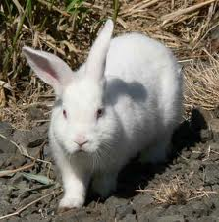
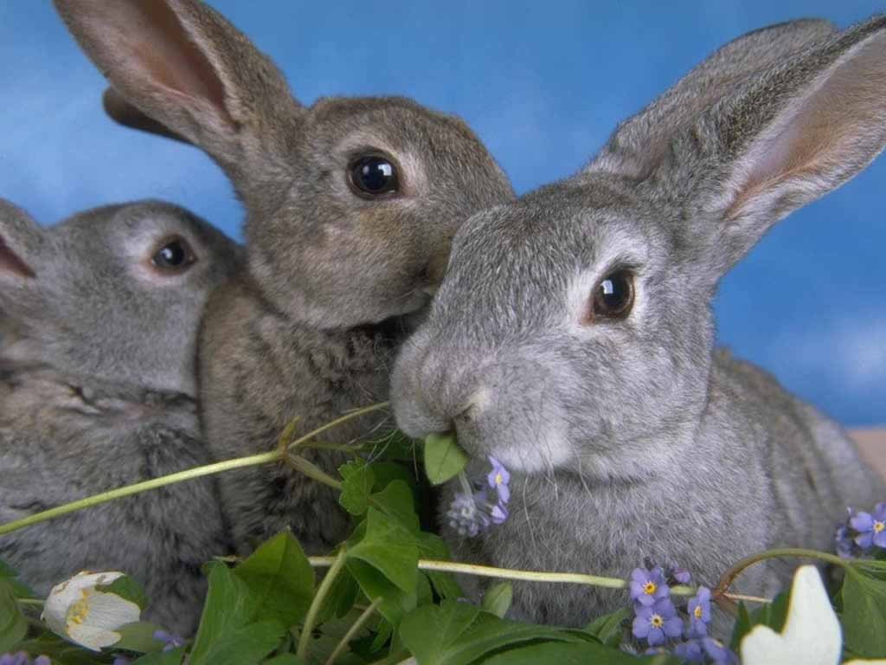

Slide 5
We’ve developed a new rabbit food, Hippity Hop.
Makes fur soft & shiny!
Hippity Hop
Increases energy!
Rabbit Food
100% of daily vitamins & essential oils!

Slide 6
Experimental unit –
the single individual (person, animal, plant, etc.) to which the different treatments are assigned
Factor – is the explanatory
variable
Hippity Hop
Rabbit Food
Level – a specific value for
the factor

Slide 7
Treatment – a specific experimental condition applied to the units
made up of factors
at different levels
Response variable – what you measure
You must be specific!

Slide 8
Example 1: A farm-product manufacturer wants to determine if the yield of a crop is different when the soil is treated with three different types of fertilizers. Fifteen similar plots of land are planted with the same type of seed but are fertilized differently. At the end of the growing season, the mean yield from the sample plots is compared.
Experimental units?
Factors?
Levels?
Response variable?
How many treatments?
Plots of land
Is this an observational study
or an experiment?
Type of fertilizer
Fertilizer types A, B, & C
Yield of crop
3

Slide 9
Example 2: A consumer group wants to test cake pans to see which works the best (bakes evenly). It will test aluminum, glass, and plastic pans in both gas and electric ovens.
Experiment units?
Factors?
Levels?
Response variable?
Number of treatments?
Cake batter
Two factors - type of pan & type of oven
Type of pan has 3 levels (aluminum, glass, & plastic & type of oven has 2 levels (electric & gas)
How evenly the cake bakes
6

Slide 10
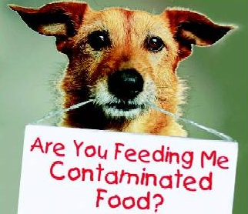
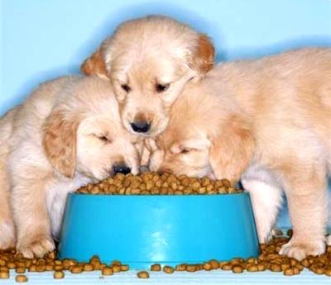
Experimental Design
In 2007, deaths of a large number of pet dogs and cats were ultimately traced to contamination of some brands of pet food. The manufacturer NOW claims that the food is safe, but before it can be released, an experiment to test whether the food is now safe for dogs and cats to eat must be conducted.
What would the treatments be?
What would the response variable be?
New food from the company, and another that I am certain is safe
Health of the pets, assessed by a veterinarian
*It may disturb you (as it does us) to think of deliberately putting dogs at risk in this experiment, but in fact that is what is done. ☹

Slide 11
Experimental Design
A group of 32 dog owners have volunteered their pets for this experimental study. Explain how you would carry out a completely* randomized experiment to see if the new food is safe for dogs to eat. The dogs will eat the assigned food for a period of 6 weeks.
*completely randomized experiment means NO BLOCKING ALLOWED!!!

Slide 12
COMPLETELY RANDOMIZED DESIGN
Group 1:
16 dogs
Treatment 1:
Dogs eat new food for 6 weeks
RANDOM
ASSIGNMENT
Group of 32 dog volunteers
Compare health of dogs, to be evaluated by veterinarian
Group 2:
16 dogs
Treatment 2:
Dogs eat “safe” food for 6 weeks
*completely randomized experiment means NO BLOCKING ALLOWED!!!

Slide 13
(explaining the randomization procedure…)
Using a RNG on a calculator/computer, RANDOMLY assign each dog a unique number from 1 to 32.
The dogs with numbers 1 – 16 are placed in treatment group 1. The rest of the dogs will be placed in treatment group 2 (or the control group).
OR
We will number the dogs from 1 to 32. Take 32 slips of paper, number them from 1 to 32, and put them in a hat. Stir the slips in the hat, then draw 16 of the slips without looking. The dogs with those numbers are placed in treatment group 1…

Slide 14
why is random assignment important?
In theory, randomization EQUALIZES all other variables (including the things we can’t predict).
BUT…
…VARIATION WILL OCCUR.
Sometimes we end up with “unfair” groups…
That is why we replicate the experiment (perform the experiment a number of times, with different groups of subjects, in different locations, etc)

Slide 15
Principles of Experimental Design
Control – make conditions as similar as possible for all treatment groups (aside from the actual treatments).
If we observe a difference between groups, we want to know that it is a result of the treatment(s)!
Randomization – the use of chance to assign subjects/units to treatments
Replication of the experiment on many subjects/in different locations/etc.

Slide 16

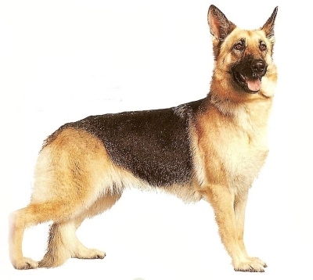
Blocking (a form of control)
Of the 32 dogs, 16 are poodles and 16 are German shepherds. Explain the changes you would make to your previous design by incorporating blocking.
It may disturb you (as it does us) to think of deliberately putting dogs at risk in this experiment… but in fact that is what is done. ☹

Slide 17
Blocking (a form of control)
Of the 32 dogs, 16 are poodles and 16 are German shepherds. Explain the changes you would make to your previous design by incorporating blocking.
We will block by breed of dog (separate poodles from German shepherds) because….
(be sure to explain WHY!)

Slide 18

RANDOMIZED BLOCK DESIGN
Group 1:
8 dogs
Treatment 1
Dogs eat new food for 6 weeks
Block A:
16 poodles
RANDOM
Compare health of dogs
Group 2:
8 dogs
Treatment 2
Dogs eat “safe” food for 6 weeks
32 dogs
BLOCK BY
BREED
Group 3:
8 dogs
Treatment 1
Dogs eat new food for 6 weeks
Block B:
16 German shepherds
RANDOM
Compare health of dogs
Group 4:
8 dogs
Treatment 2
Dogs eat “safe” food for 6 weeks

Slide 19
Blocking
Blocking is to experiments
as ________ is to sampling.
stratifying

Slide 20
Is the difference in our results
statistically significant?
(what does that even mean???)

Slide 21
“statistically significant”
An observed effect so large that it would rarely occur by chance is called statistically significant.

Slide 22
SAT PREP CLASSES! (blegh!)
Higher SAT scores in only 6 weeks!
top-secret far-eastern study strategies!
3 sessions a week, only 5 hours per session!
all the other kids are being forced into it by their parents, so why not!?!
Cost: only $30,000!!! What a bargain!
Scores will improve (guaranteed!) or your money back!!!

Slide 23
SAT PREP CLASSES!
…take this SAT class…
Group of 20 students
…mean score improvement of…
18 points!!!
IT WORKED!!!

Slide 24
CONTROL GROUP
a group that is used to compare the factor against; can be a placebo or the “old” or current item

Slide 25
SAT PREP CLASSES!
GROUP A:
These 10 kids CARE about their grades… and choose to take this SAT class…
Group A scored WAYYY higher!!!
IT WORKED!!!
Group of 20 students
GROUP B:
These 10 kids DON’T CARE about their grades… and DON’T take this SAT class…

Slide 26
CONFOUNDING
Two variables are confounded when they BOTH have an association with the response variable (and we cannot tell which is responsible for the effect).
LURKING VARIABLE
Something we didn’t think about that has an important effect on the response variable.

Slide 27
(an example of possible CONFOUNDING…)
Professor at Cornell – effect of teaching style on student evaluations of the professor
Fall and Spring terms – total of 472 students Teaching identical except for style:
subdued in fall… enthusiastic in spring!
average response:
Fall: 2.93 Spring: 4.05
Could the weather have been confounding?
Notes:
Cornell will have gloomy weather in the fall and nice weather in the spring.

Slide 28
According to Newsweek:
  “Of all pre-college curricula, the highest level of mathematics one studies in secondary school has the strongest continuing influence on bachelor’s degree completion. Finishing a course beyond the level of Algebra 2 (for example, trigonometry or pre-calculus*) more than doubles the odds that a student who enters postsecondary education will complete a bachelor’s degree.”
  Propose a study design that might enable us to draw this conclusion. Why would it be difficult (and probably unethical) to perform this study?
*or AP Statistics!!!

Slide 29
about “control”…

Slide 30
testing a new headache medicine…
Group 1:
20 patients
Treatment 1:
Patient takes the new pill
RANDOM
ASSIGNMENT
Sigh… Look at me, I didn’t get the “good stuff”… I’m a loser, I think I’ll go get a headache now… ☹
Group of 40 volunteers
Compare numbers of headaches…
Group 2:
20 patients
Control:
Patient gets no pill

Slide 31
PLACEBO
a “dummy” treatment that has no effect on the response variable.
(sometimes we say “no physical effect” but…)

Slide 32
testing a new headache medicine…
Group 1:
20 patients
Treatment 1:
Patient takes the new pill
RANDOM
ASSIGNMENT
Group of 40 volunteers
Compare numbers of headaches…
Group 2:
20 patients
Control:
Patient gets placebo

Slide 33
BLINDING
units do not know which treatment they are getting
DOUBLE BLIND
neither the subjects nor the evaluator* know which treatment a subject received
*(nor anybody who administers the treatments and/or cares for the subjects… basically ANYBODY who interacts directly with the experimental units)

Slide 34
placebos?
A pharmaceutical company is testing a new headache medicine pill, and wishes to test it in an experimental study against a control group. Is it possible for the experiment to be blinded? double blinded?
  The subjects can be blinded by being given a placebo – a dummy pill which looks and feels the same as the “real” drug, but contains no active ingredient.
  The evaluators* should also be blinded by not knowing which group received the real drug vs. the placebo (assignment of treatments should be administered by a 3rd party).
  *or anyone that deals directly with the patients

Slide 35
more placebos…?!
A cutting-edge treatment for combatting brain tumors involves drilling tiny holes in the patient’s skull and injecting a drug cocktail into the brain.
Is it possible to carry out a double-blind experiment in this scenario? Explain…
Sure… just drill holes in the skulls of the control group patients and inject a non-active “dummy” cocktail into their brains… ☹
(is it ethical??)

Slide 36
ex: ulcers in upper intestine
Treatment for stomach ulcers
  Anesthetize patient
  Put balloon in stomach
Fill with freezing coolant
Initial Experiment, 1958
24 patients, all cured
Became popular, and better than surgery
But there were some skeptics….

Slide 37
Was it a Placebo Effect???
New Approach, 1963:
Controlled Experiment
(some treated, others not;
shows who gets better with no treatment)
2nd experiment divided 160 ulcer patients into 2 groups:
1 - freezing 2 – placebo
34% of 82 patients 38% of 78
gastric freezing no better than placebo!!
Why was a comparison better?

Slide 38
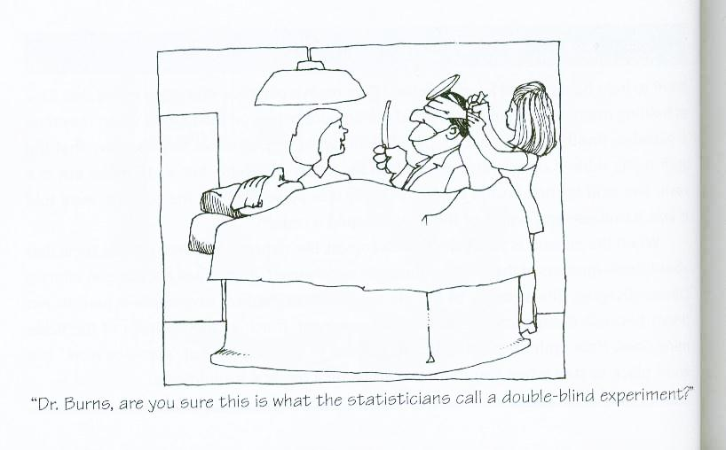
::halftime::
Homework #7 is on the calendar!

