Slide 1
Scatterplots Association and Correlation
Chapter 7

Slide 2
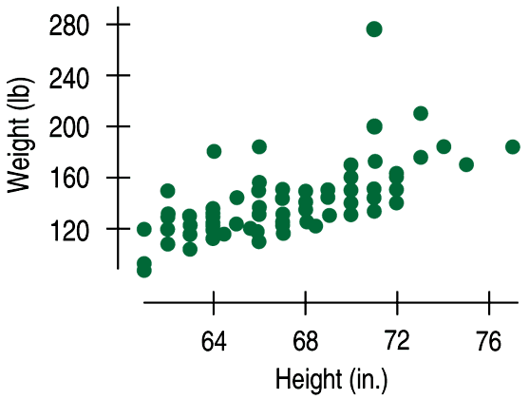
DESCRIBING SCATTERPLOTS
Data collected from students in Statistics classes included their heights (in inches) and weights (in pounds):

Slide 3
DESCRIBING ASSOCIATION
If you are asked to “describe the association” in a scatterplot, you must discuss these three things:
STRENGTH (weak, moderate, strong)
FORM (linear or non-linear)
DIRECTION (positive? negative?)

Slide 4
DESCRIBING ASSOCIATION
Data collected from students in Statistics classes included their heights (in inches) and weights (in pounds):
Here we see a moderate, positive association and a fairly straight form, although there seems to be a high outlier.

Slide 5

SAT MATH AND SAT VERBAL SCORES
Is there an association?
Is it strong… weak….
positive… negative….
linear… curved?

Slide 6
How about this graph?

Slide 7
Since our eyes are not always good judges of assessing the STRENGTH of a linear association, we need a NUMERICAL MEASURE…

Slide 8
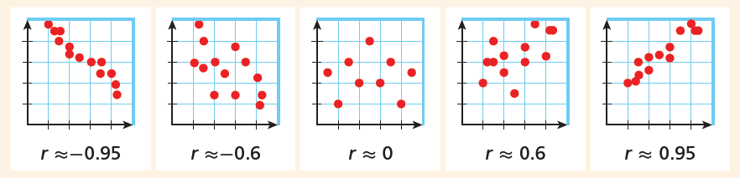
Correlation Coefficient (r)
Correlation is always between -1 and 1.
strong
moderate
weak (or “moderately weak”)

Slide 9
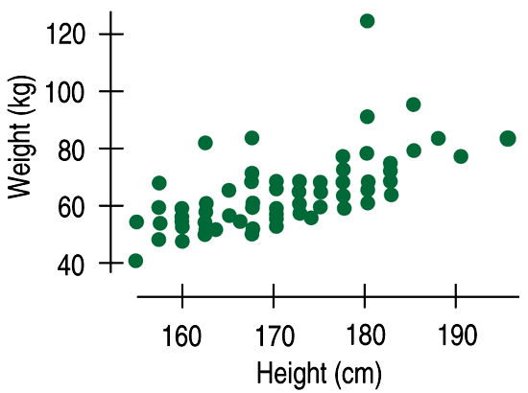
Correlation
does not depend on the units.
SCALING AND SHIFTING DO NOT AFFECT CORRELATION.

Slide 10
Correlation
treats x and y symmetrically. If we swap x and y, the correlation does not change.

Slide 11
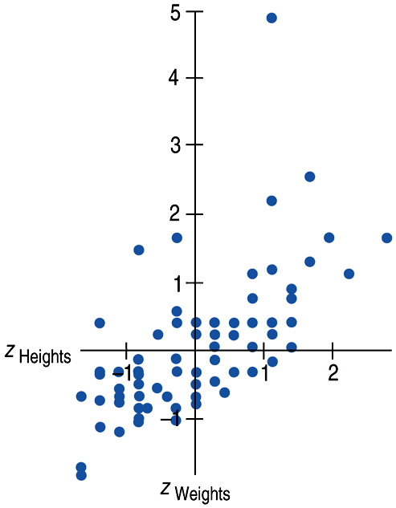
Calculating Correlation…
(don’t worry, you’ll never have to do it by hand)
Since the units don’t matter, why not remove them altogether?
We could standardize both variables and write the coordinates of a point as (z_{x}, z_{y}).
Here is a scatterplot of the standardized weights and heights:

Slide 12
Correlation Coefficient (r)
is calculated by doing a mathematical mash-up of the z-scores for EVERY POINT’S x-coordinate AND y-coordinate. It’s tedious.

Slide 13
CORRELATION
measures the strength of the
LINEAR association
between two QUANTITATIVE variables.
is UNIT-LESS.
is SENSITIVE TO OUTLIERS (since correlation is calculated from z-scores – which are based on means and standard deviations)

Slide 14
Correlation is very sensitive to outliers.
The correlation between shoe size and IQ is surprisingly strong.
(what?!??!)
r = 0.40
r = -0.005!!

Slide 15
(what’s wrong?)
There is a high correlation between the gender of American workers and their income.
Gender of American workers is categorical, not quantitative.

Slide 16
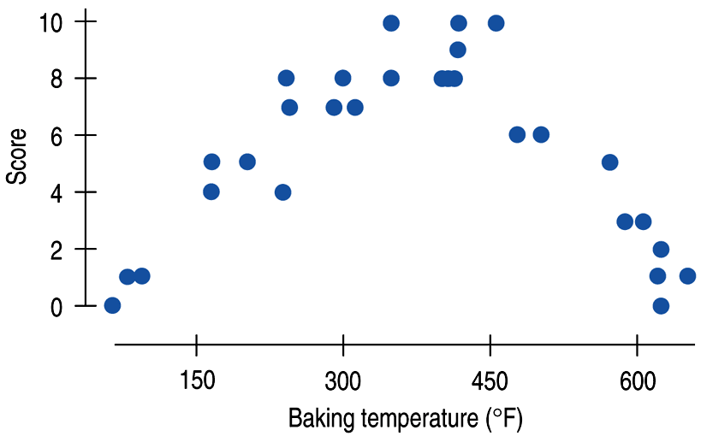
Correlation measures the strength of
a linear relation only.
You can calculate a correlation coefficient for any pair of variables, but it will be misleading if the relationship is not linear.

Slide 17
(what’s wrong?)
“We found a high correlation (r = 1.09) between students’ ratings of faculty teaching and ratings made by other faculty members.”
“The correlation between planting rate and yield of corn was found to be r = 0.23 bushels.”

Slide 18
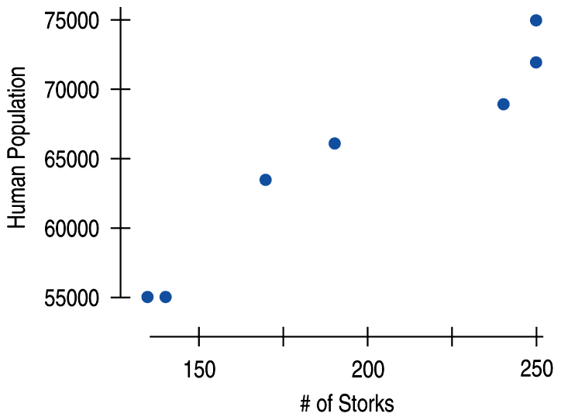
Don’t confuse correlation with causation.
Association does NOT imply causation.

Slide 19
fin~

