Slide 1
CUSSing & BS-ing practice
Center: This distribution of quiz scores appears to have two modes, one at around 55, and another at around 80.
Shape: The shape is bimodal, and around each mode the shape is roughly symmetric.
Spread: The spread is from the mid-30’s to the mid-90’s.
Unusual features: There is a gap in the lower 40’s, with a possible outlier in the mid 30’s.

Slide 2

more CUSSing & BS-ing…
Center: This distribution of grades has a single mode at around 100.
Shape: The shape is unimodal and skewed to the left (to the lower grades)
Spread: The spread is from the mid-50’s to about 100.
Unusual features: There is a gap from the upper 50’s to the upper 60’s, with a possible outlier in the mid 50’s.
this does NOT mean that someone had a grade of above 100.
(more likely, a lot of 98’s and/or 99’s)

Slide 3
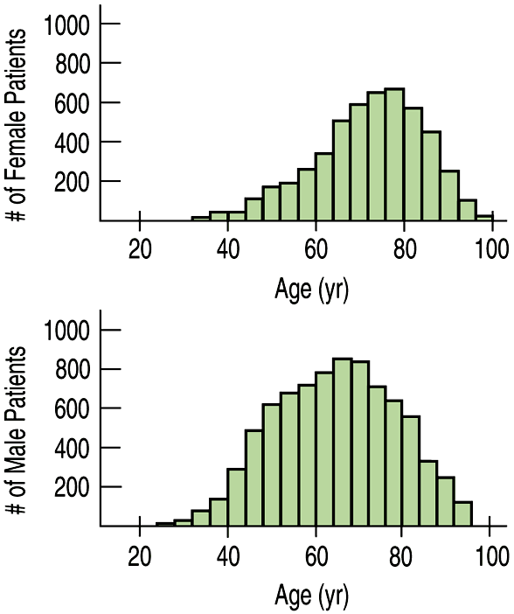
Comparing Distributions
Compare the following distributions of ages for female and male heart attack patients.

Slide 4
Comparing Distributions
Be sure to use language of comparison.
Center: This distribution of ages for females has a higher center (at around 78) than the distribution for male patients (around 62).
Shape: Both distributions are unimodal. The distribution for males is nearly symmetric, while the distribution for females is slightly skewed to the lower ages.

Slide 5
Comparing Distributions
Spread: Both distributions have similar spreads: females from around 30 – 100, and males from about 24 – 96. Overall, the distribution for female ages is slightly higher than that for male ages.
(There are no unusual features)
YOU MUST USE COMPLETE SENTENCES!!!

Slide 6
Describe and Compare
CENTER – describe the peaks (modes). Compare them (which is higher/lower) and give specific numerical values.
SHAPE – How many modes? Roughly symmetric or skewed? (never use the word “symmetric” without the word “roughly”)
SPREAD – How far do the distributions spread out? Is one more spread out than the other? Give specific numerical values.
UNUSUAL FEATURES – Gaps? Outliers?

