Slide 1
Geometric and Binomial Models
(part un)
AP Statistics
Chapter 17

Slide 2
Two types of probability models for Bernoulli Trials:
Geometric Probability Model –
repeating trials until our first success.
Binomial Probability Model –
describes the number of successes in a
specified number of trials.

Slide 3
A BERNOULLI TRIAL is an experiment whose outcome is random…
3 conditions must be met:
B (bi) – two possible outcomes – success or failure
I (independent) – does the occurrence of one event significantly* change the probability of the next?
S – is the probability of success the same on every trial?

Slide 4
Our first post-
Turkey break QUIZ

Slide 5
The Geometric model
Geom(p)
p = probability of success
(q = probability of failure = 1 – p)
X = number of trials until the first success occurs

Slide 6
1. The Hungarian Problem
(working with a Geometric Model)
On the “Hungarian Quiz” that we just took…
how many questions do you expect to answer until you get one correct?
What’s the probability that the first question you answer correctly is the 4th question?
p = 0.25
X = number of questions until we get one correct

Slide 7
1. The Hungarian Problem
(working with a Geometric Model)
On the “Hungarian Quiz” that we just took…
What is the probability that the first question you answer correctly is the 4th or 5th or 6th question? (eek)
p = 0.25
X = number of questions until we get one correct

Slide 8
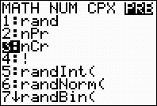
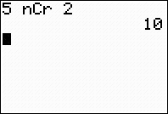
Before getting into binomials, some basic combinatorics…
2 people from the following list will be randomly selected to win A MILLION DOLLARS!!! How many different combinations of TWO names are possible?
Alf Bob Chuck Doogie Emily

Slide 9
The Binomial model
Binom(n, p)
n = number of trials p = probability of success
(q = probability of failure = 1 – p)
X = number of successes in n trials

Slide 10
2. The “Hungarian” Problem II
(working with a Binomial Model)
On that 10 question “Hungarian Quiz”…
What are the mean and standard deviation of the number of correctly answered questions?
What is the probability that a student got exactly 4 questions correct?

Slide 11
So… why do we need the nCr in front???
(10 questions, 0.25 probability on each guess, EXACTLY 4 correct…)
#1 | #2 | #3 | #4 | #5 | #6 | #7 | #8 | #9 | #10
YES | YES | YES | YES | NO | NO | NO | NO | NO | NO
YES | YES | NO | YES | YES | NO | NO | NO | NO | NO
HOPEFULLY YOU GET THE IDEA…
(there are a LOT of ways for us to get 4 out of 10)
YES | NO | YES | YES | NO | NO | NO | YES | NO | NO
NO | NO | YES | YES | NO | YES | NO | NO | YES | NO
NO | NO | NO | NO | NO | NO | YES | YES | YES | YES
etc. etc. etc…

Slide 12
2. The “Hungarian” Problem II
(working with a Binomial Model)
On that 10 question “Hungarian Quiz”…
What is the probability that a student answered no more than 5 correctly?

Slide 13
So for this scenario…
(10 questions, 0.25 probability on each guess)
P(0) + P(1) + P(2) + P(3) + P(4) + P(5) + P(6) + P(7) + P(8) + P(9) + P(10)
= 1.0

Slide 14
2. The “Hungarian” Problem II
(working with a Binomial Model)
On that 10 question “Hungarian Quiz”…
What is the probability that a student answered at least 1 question correctly? (think back…)

Slide 15
2. The “Hungarian” Problem II
(working with a Binomial Model)
On that 10 question “Hungarian Quiz”…
What is the probability that a student answered at least 4 questions correctly? (ugh…)
P(0) + P(1) + P(2) + P(3) + P(4) + P(5) + P(6) + P(7) + P(8) + P(9) + P(10)

Slide 16
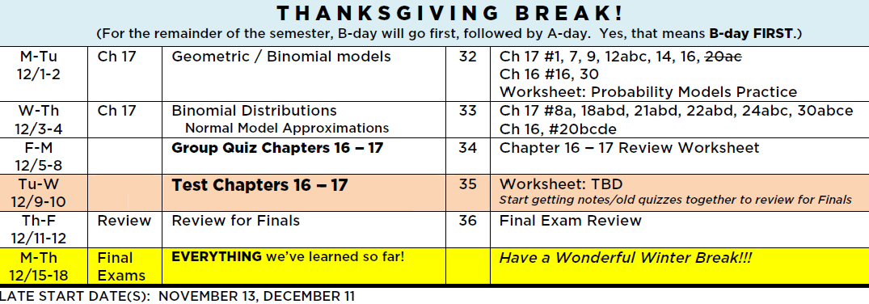
Fix your calendar:
Delete #20!!!

Slide 17


