Slide 1
Inference with Means
(one sample)
AP Statistics
Chapter 23

Slide 2

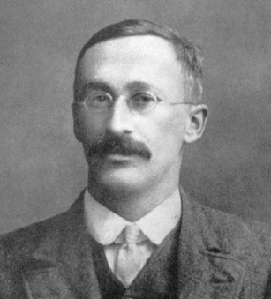
William Gossett
1876 - 1937
Guinness employee
Dublin, Ireland
“Quality Assurance”
(a.k.a., taste tester) for Guinness beer
(horrible, job, right?)

Slide 3
William Gossett
Taste-tested batches of dark lager in samples
Calculated that he should reject good beer about 5% of the time
Actually rejected good beer about 15% of the time (WHAT?!)
Found that the Normal model doesn’t play nice with small samples…

Slide 4
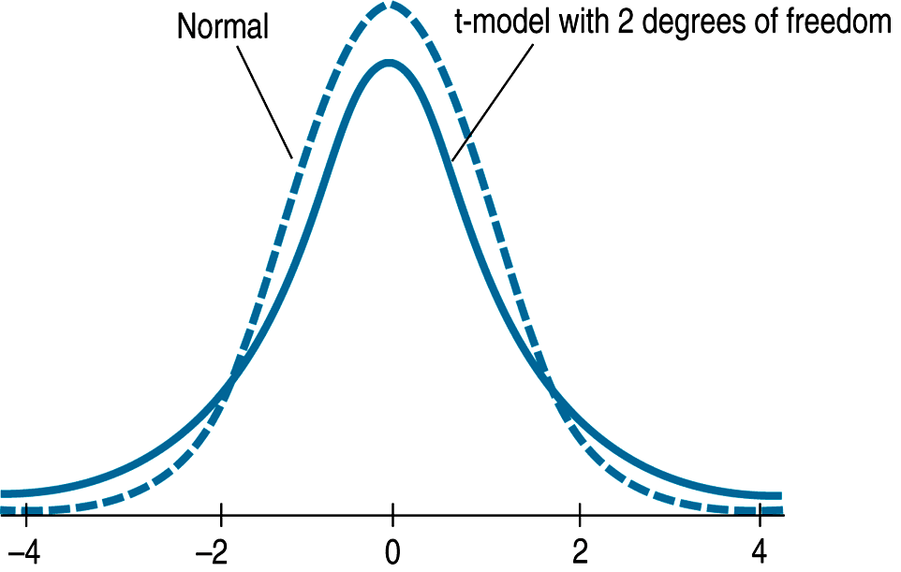
The Student’s t-models
What Does This Mean for Means?
These curves have more area in the tails
(Because we are using “s” to estimate “σ”, there is greater “uncertainty”/variability)

Slide 5
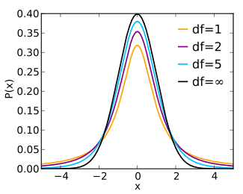
The Student’s t-models
What Does This Mean for Means?
Degrees of freedom (df)
Each sample size has
its own model/curve!
For 1-sample means:
df = n – 1

Slide 6
Student’s t-models
(you want to write this stuff down…)
Use when we don’t know the population standard deviation σ (when we use the sample standard deviation as an estimate for σ)
t-distribution has fatter tails than z-distribution
As df increase, the t-models look more and more like the Normal model.
In fact, the t-model with infinite degrees of freedom is exactly Normal.

Slide 7
Calculating t vs z
(you want to write this down too…)
If we know σ:
(population SD)
If we only know s:
(sample SD)

Slide 8
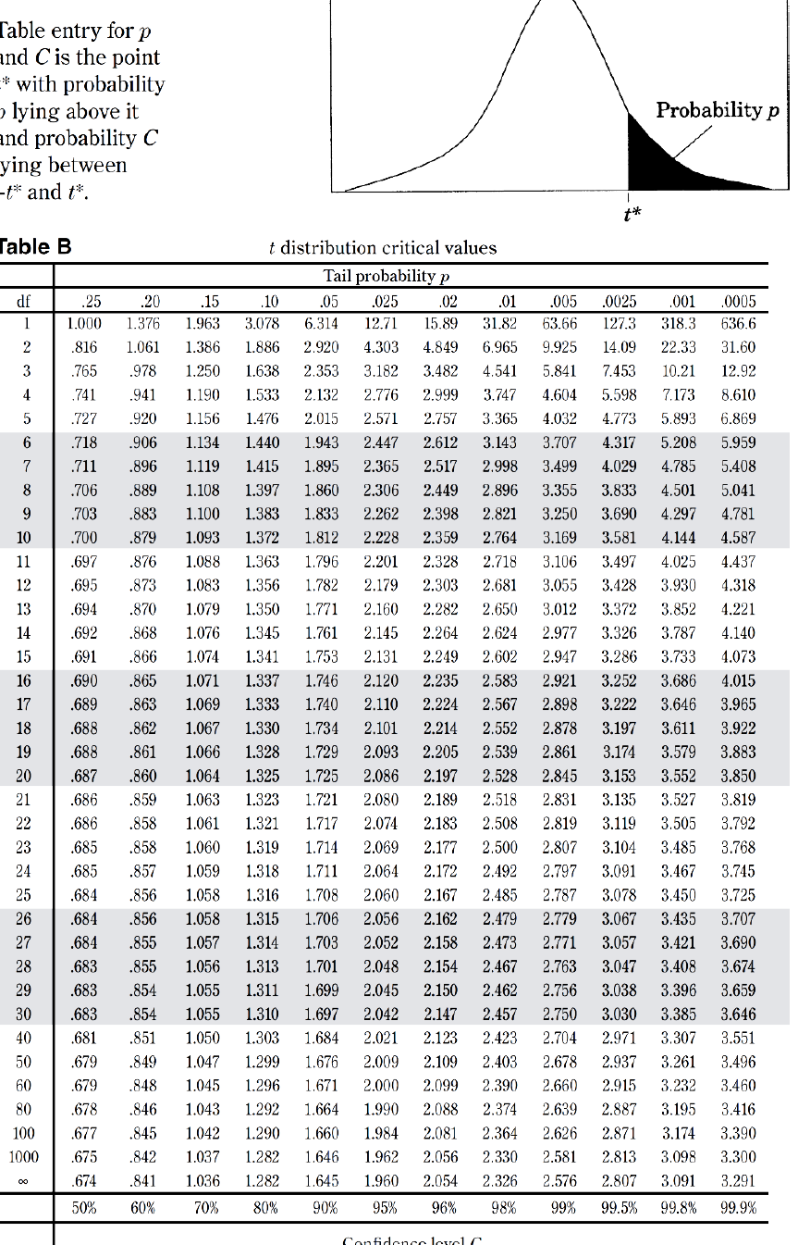
t-table Practice
Find the critical value of t for
95% confidence with…
df = 10
n = 20
df = 32
t* = 2.228
t* = 2.093
(use df = 20 – 1 = 19)
t* = 2.042
(use df = 30 – round DOWN)

Slide 9
conditions for inference with 1-sample means
Randomization
Have an SRS or representative of population
10% Condition
This is not as important to check for means, as sample sizes are usually very small, but it never hurts to be safe.
Nearly Normal Condition
Check for one of the following:
  Given that population is roughly normally distributed
  Large enough sample size (n > 30) – CLT
  Check graph (dotplot is easy to make by hand)
  and check for plausible normality
  watch out for outliers!!!

Slide 10
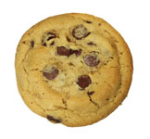
Our first problem with real “data”
Let’s pretend that the Chip’s Ahoy company claims a mean of 24 chips per cookie… do we have statistical evidence (at α = 0.05) to doubt them?
Suppose we take a random sample of 10 of the company’s cookies, and get the following counts for # of chocolate chips:
21 28 19 19 23 18
18 19 26 17 26 27

Slide 11
One-sample t-test
μ = true mean # of chips per cookie
Ho: μ = 24
Ha: μ < 24
(because we probably wouldn’t be concerned if we got MORE than 24 chips per cookie)
Conditions:
We have a random sample of the company’s cookies
(Since n < 30, we must make a graph...)
The graph of sample data shows no outliers, so normality should be plausible.

Slide 12
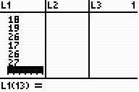
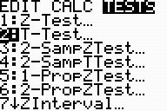
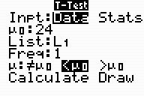
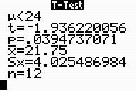
One-sample t-test
μ = true mean # of chips per cookie
Ho: μ = 24
Ha: μ < 24
(fill in numbers in the formula, then just use the “t” and “p-value” from calculator)
t = -1.93 p = 0.394 df = 11
Since p < alpha, we reject Ho.
We HAVE evidence that the mean # of chips per cookie is less than 24.

Slide 13
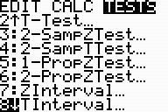
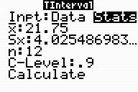
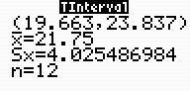
Estimate the mean number of chocolate chips per cookie by using a 90% confidence interval
One-sample t-interval
(again, fill in numbers in the formula, then just get the interval from the calculator)
(19.633, 23.837)
We are 90% confident that the true MEAN number of chips per cookie is between 19.633 and 23.837.

Slide 14
Homework #14
Ch 23 p.541 #2, 7, 10, 11, 13a-c, 15, 21, 31
skip 2c & 2d

