Slide 1
Linear Regression
Chapter 8

Slide 2

Linear Regression
AP Statistics – Chapter 8
We use actual values for “x”… so no hat here.
$$\hat{y}=b_{0}+b_{1}x$$
We are predicting the y-values, thus the “hat” over the “y”.
slope
y-intercept

Slide 3

Is a linear model appropriate?
Check 2 things:
Is the scatterplot fairly linear?
Is there a pattern in the plot of the residuals?

Slide 4
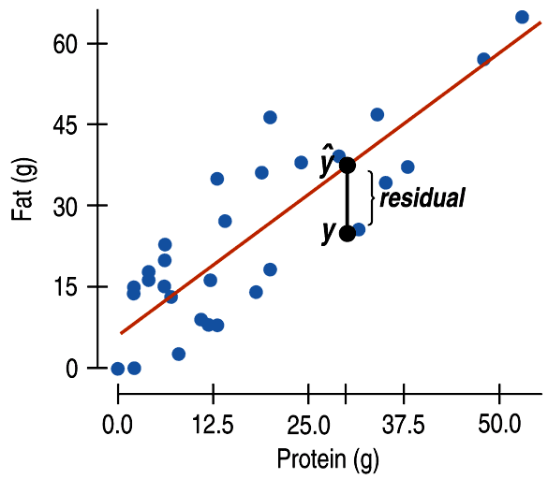

Residuals
(difference between observed value and predicted value)
Believe it or not, our “best fit line” will actually MISS most of the points.
Residual:
Observed y – Predicted y $$e=y−\hat{y}$$

Slide 5
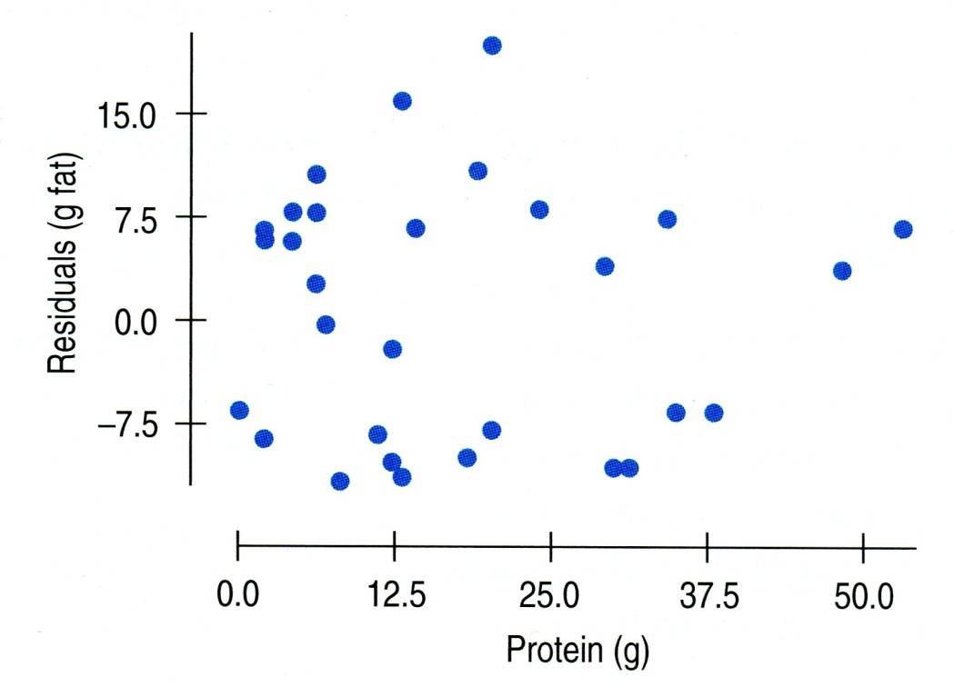
Every point has a residual...
and if we plot them all, we have a residual plot.
We do NOT want a pattern in the residual plot!
This residual plot has no distinct pattern… so it looks like a linear model is appropriate.

Slide 6
Does a linear model seem appropriate?
OOPS!!!
Although the scatterplot is fairly linear… the residual plot has a clear curved pattern. A linear model is NOT appropriate here.

Slide 7
Is a linear model appropriate?
A residual plot that has no distinct pattern is an indication that a linear model might be appropriate.
Linear
Not linear

Slide 8
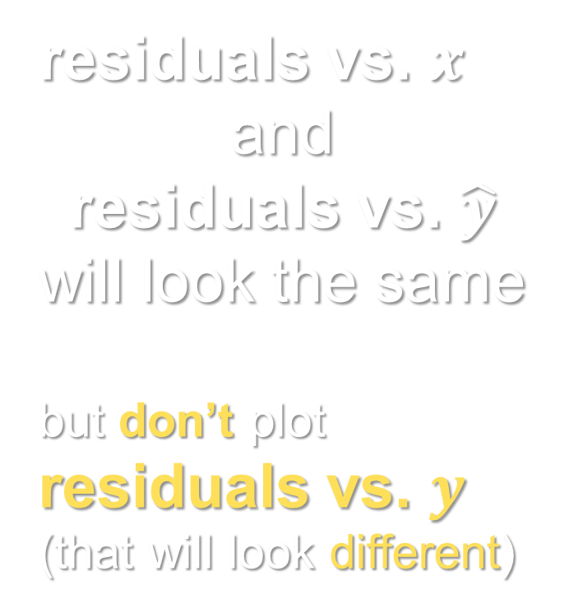
Note about residual plots
residuals vs. $x$
and
residuals vs. $\hat{y}$
will look the same
but don’t plot
residuals vs. $y$
(that will look different)

Slide 9
Least Squares Regression Line
Consider the following 4 points:
(1, 3) (3, 5) (5, 3) (7, 7)
How do we find the best fit line?

Slide 10
Least Squares Regression Line
is the line (model) which minimizes the sum of the squared residuals.

Slide 11
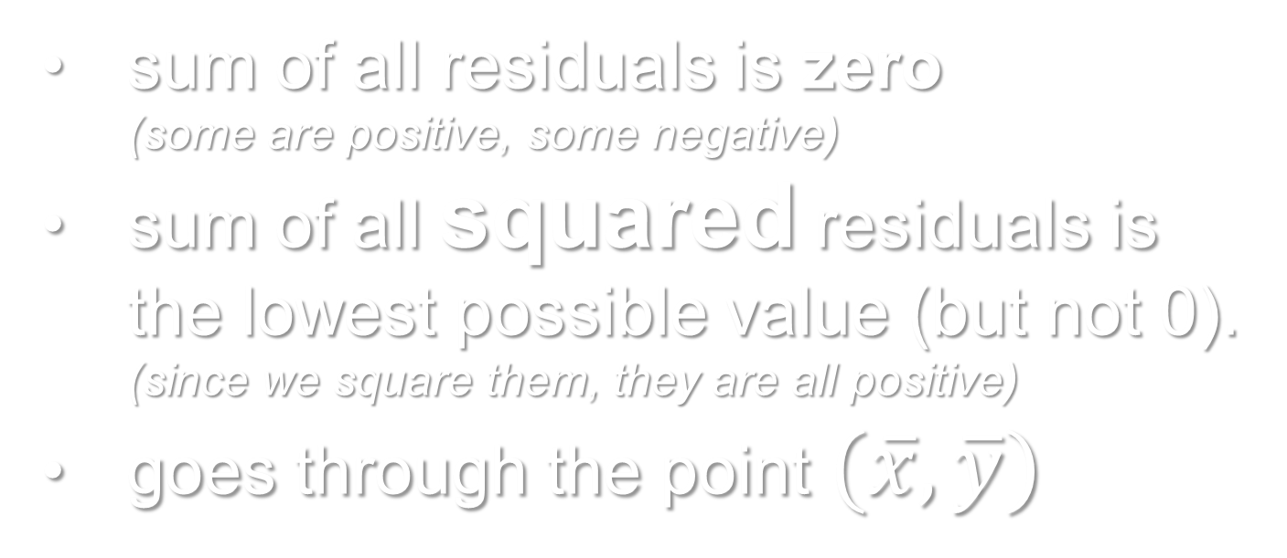
Facts about LSRL
sum of all residuals is zero (some are positive, some negative)
sum of all squared residuals is the lowest possible value (but not 0). (since we square them, they are all positive)
goes through the point $(\overline{x}, \overline{y})$

Slide 12
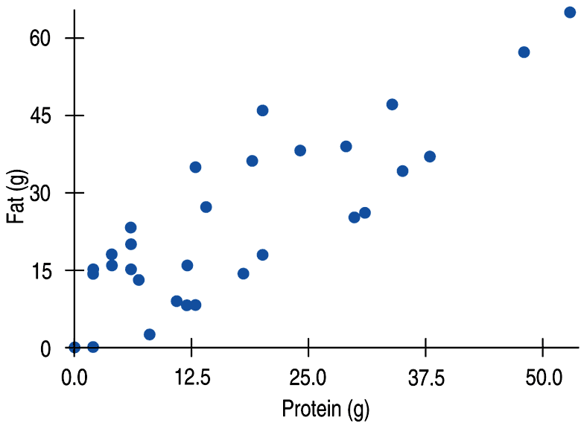
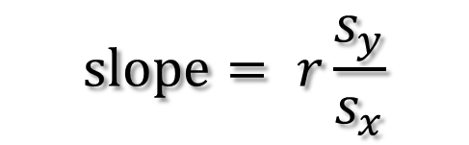


Regression line always contains (x-bar, y-bar)
$$\overline{x}$$
least squares line
$$\overline{y}$$
$$slope= r\frac{s_{y}}{s_{x}}$$

Slide 13
Regression Wisdom
Chapter 9

Slide 14
Let’s look at height vs. age:
(this is cm vs months!)
$$\hat{height}=64.93+0.635∗age$$
This model states that an 18-month old is predicted to be about 76 or 77 cm tall. (that’s about 30 inches, or 2.5 feet)
Also, a 30-month old is predicted to be about 84 cm tall. (that’s about 33 inches)
THESE ARE FAIRLY REASONABLE…

Slide 15


Another look at height vs. age:
(this is cm vs months!)
$$\hat{height}=64.93+0.635∗age$$
What does the model predict about the height of a 180-month (15-year) old person?
$$\hat{height}=64.93+0.635(180)$$
$\hat{height}=179.23$ cm… or about 70.56 inches!
(that’s 6 feet, 8 inches!)
THAT’S A TALL 15-YEAR OLD!!!

Slide 16

…what about a 40-year old human…
$$\hat{height}=64.93+0.635∗age$$
$$\hat{height}=64.93+0.635(480)$$
$\hat{height}=369.73$ cm… or 145.56 inches!
(that’s 12 feet, 1.56 inches!)

Slide 17
Extrapolation
(going beyond the useful ends of our mathematical model)
Whenever we go beyond the ends of our data (specifically the x-values), we are extrapolating.
Extrapolation leads us to results that may be unreliable.

Slide 18
Outliers…
Leverage…
Influential points…

Slide 19
Outliers, leverage, and influence
If a point’s x-value is far from the mean of the x-values, it is said to have high leverage. (it has the potential to change the regression line significantly)
A point is considered influential if omitting it gives a very different model.

Slide 20
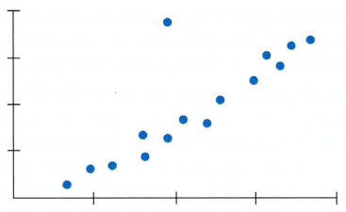
Outlier or Influential point? (or neither?)
Outlier:
- Low leverage
- Weakens “r”
WITHOUT
“outlier”
WITH
“outlier”
(model does not change drastically)

Slide 21
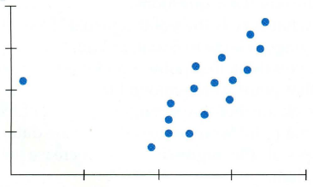
Outlier or Influential point? (or neither?)
Influential Point:
- HIGH leverage
- Weakens “r”
WITHOUT
“outlier”
WITH
“outlier”
(slope changes drastically!)

Slide 22
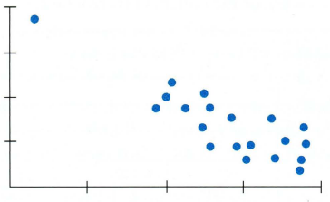
Outlier or Influential point? (or neither?)
- HIGH leverage
- STRENGTHENS “r”
Linear model
WITH and
WITHOUT
“outlier”

Slide 23
fin~

