Slide 1
CATEGORICAL DATA CHAPTER 3
GET A CALCULATOR!

Slide 2
CATEGORICAL DATA chapter 3
THE THREE RULES OF DATA ANALYSIS
won’t be difficult to remember:
Make a picture — things may be revealed that are not obvious in the raw data. These will be things to think about.
MAKE A PICTURE — important features of and patterns in the data will show up. You may also see things that you did not expect.
MAKE A PICTURE — the best way to tell others about your data is with a well-chosen picture.

Slide 3


Slide 4
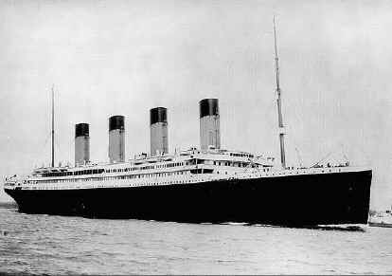

Slide 5
Launched: 31st May 1911 Builders: Harland and Wolff, Belfast Port of Registry: Liverpool Passengers Lost: 818 (62%) Crew Lost: 684 (77%) Total Lost: 1,502 (68%)

Slide 6
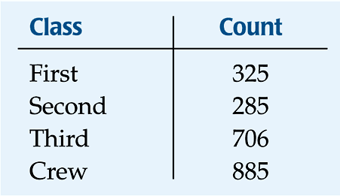
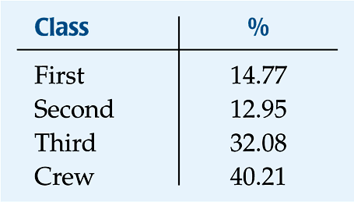
DISTRIBUTION name of categories and how frequently each occurs
Frequency distribution
Relative frequency distribution

Slide 7
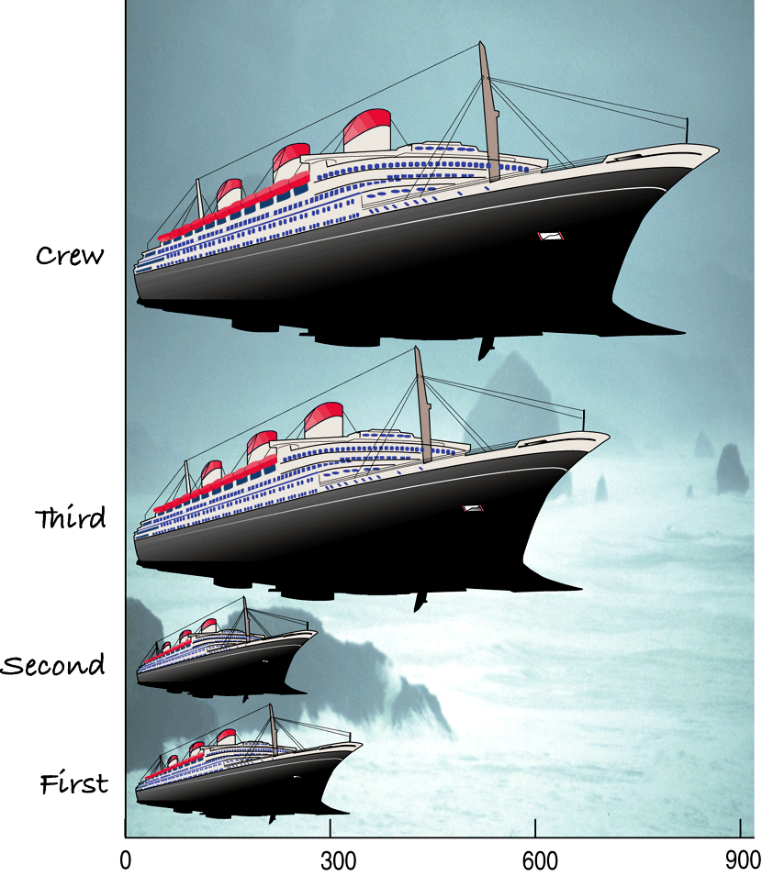
What do you see?
this is a Violation of the “Area Principle”
When we look at each ship, we see the area taken up by the ship, instead of the length of the ship.

Slide 8
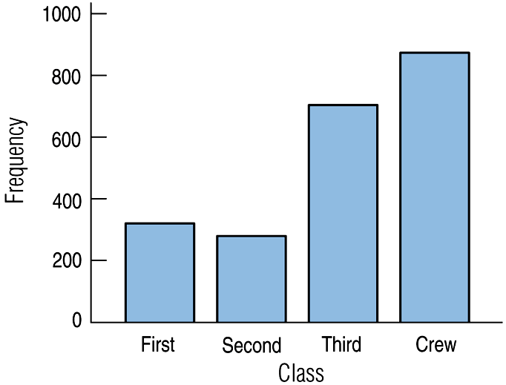

BAR GRAPHS
A bar chart displays the distribution of a categorical variable, showing the counts for each category next to each other for easy comparison.
A bar chart stays true to the area principle.
For bar charts (with categorical data), be sure to leave spaces between the bars!!!

Slide 9
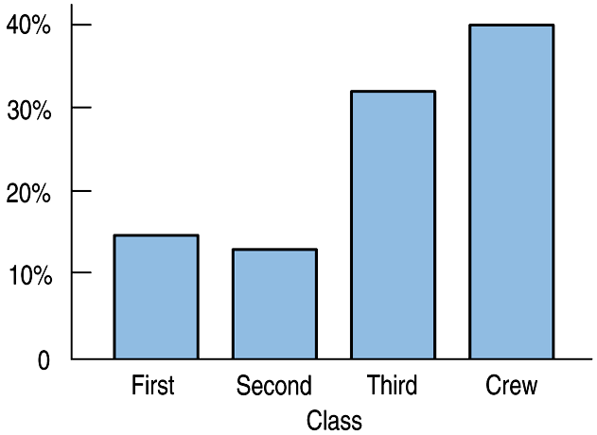
BAR CHARTS
A relative frequency bar graph displays the relative proportion of counts for each category.

Slide 10
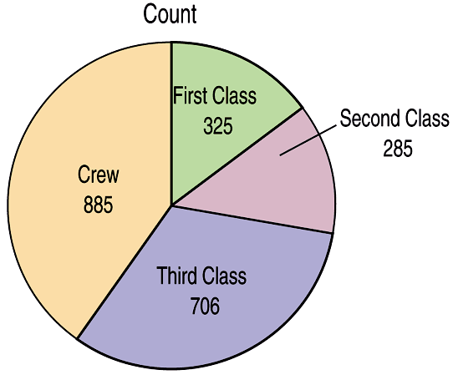
Pie Charts
When you are interested in parts of the whole,
a pie chart might be your display of choice.

Slide 11
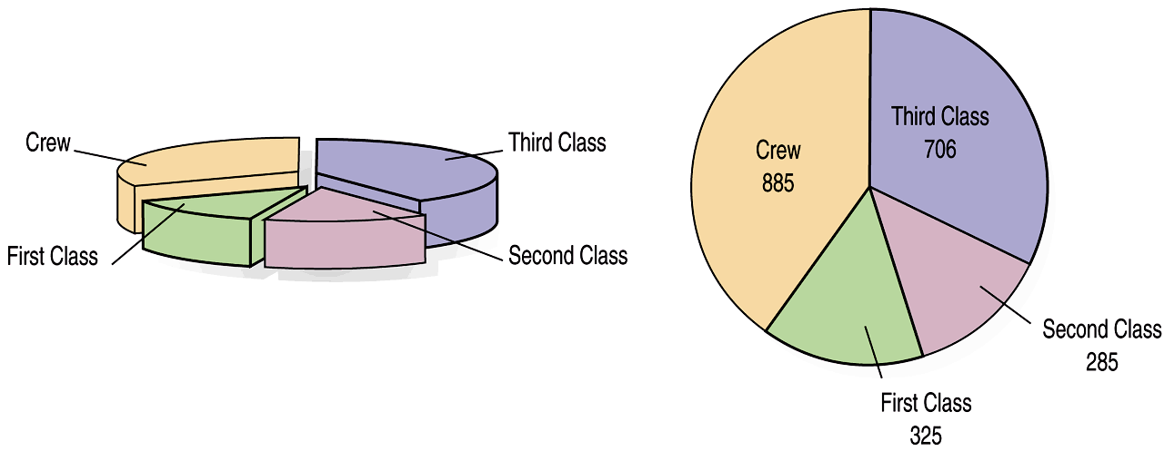
WHAT CAN GO WRONG?
While some people might like the pie chart on the left better, it is harder to compare fractions of the whole, which a well-done pie chart does.

Slide 12
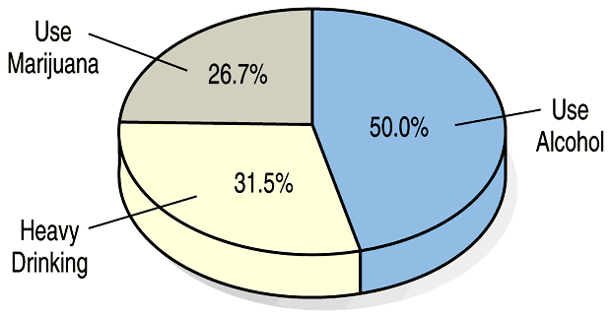
WHAT CAN GO WRONG?
This plot of the percentage of high-school students who engage in specified dangerous behaviors has a problem. Can you see it?
if you are making a pie chart with percentages (or proportions), make sure the percentages add up to 100%!!!

Slide 13
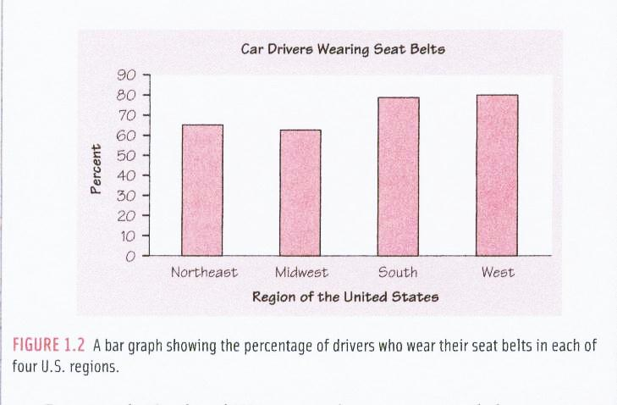
In which region do the greatest NUMBER of people wear seatbelts?

Slide 14
Note: we are using the word “proportion” (or “percentage”)… …NOT the word “number”
Overall, the bar chart shows that all four regions of the country have more than 60% of car drivers wearing seat belts.
The Midwest has the smallest proportion of car drivers wearing seat belts (about 62%) where the South and West have the largest proportion (about 78- 80%).

Slide 15
back to the Titanic…

Slide 16
A 2-WAY TABLE (OR “CONTINGENCY” TABLE) allows us to look at two categorical variables together.
Class
 | First | Second | Third | Crew | Total
Alive | 203 | 118 | 178 | 212 | 711
Dead | 122 | 167 | 528 | 673 | 1490
Total | 325 | 285 | 706 | 885 | 2201
Survival
marginal distributions

Slide 17
SIDE-BY-SIDE BAR GRAPH (FOR COUNTS)

Slide 18
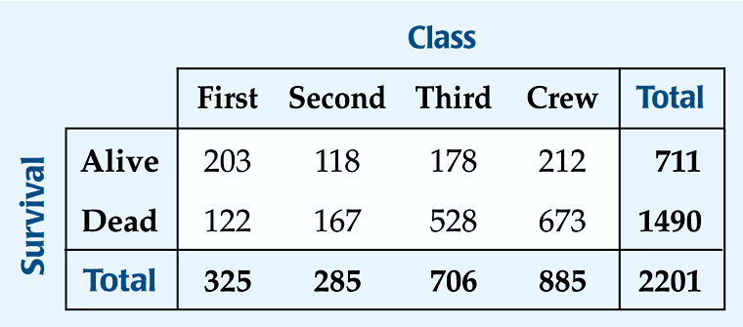
What percent of the people on the Titanic died?
What percent of the people were surviving crew?
*What percent of the survivors were First class?
*What percent of First class survived?
1490/2201 = 67.7%
212/2201 = 9.6%
203/711 = 28.6%
203/325 = 62.5%

Slide 19
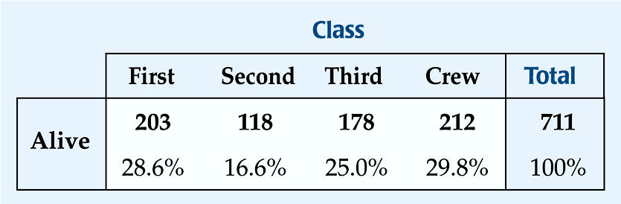
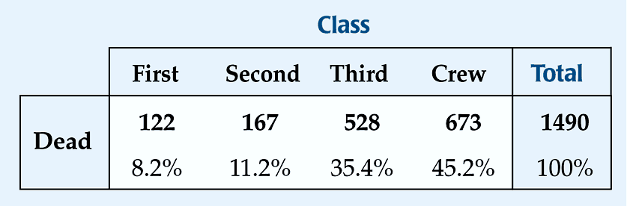
CONDITIONAL DISTRIBUTIONS
Separated on the CONDITION of SURVIVAL:

Slide 20
c) Construct a graphical display that shows the association between “class” and “survival”. Write a few sentences describing the association between class and survival status.
To check for an association between
variables, you MUST compare
PROPORTIONS (not COUNTS!!!)

Slide 21
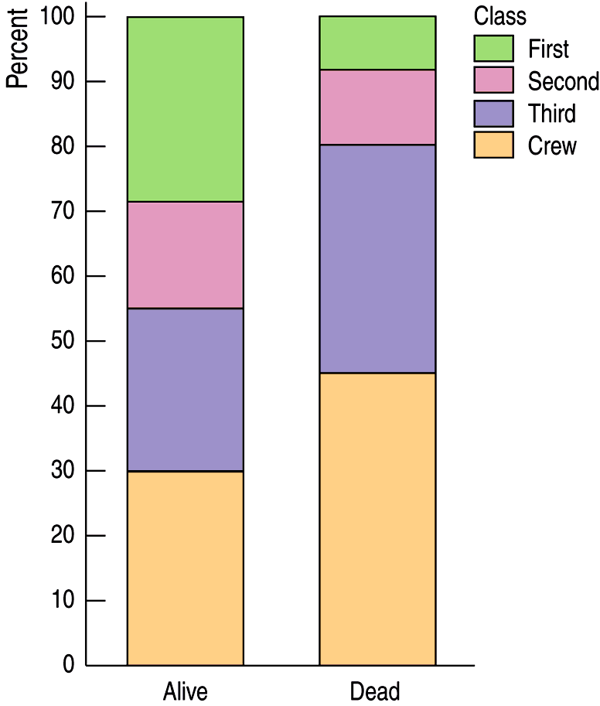
SEGMENTED BAR GRAPH
A segmented bar graph displays the same information as a pie chart, but in the form of bars instead of circles.
Proportion

Slide 22
SEGMENTED BAR GRAPH
A segmented bar graph displays the same information as a pie chart, but in the form of bars instead of circles.
FIRST
FIRST
SECOND
SECOND
THIRD
THIRD
CREW
CREW

Slide 23
SEGMENTED BAR GRAPH
…DESCRIBE THE ASSOCIATION BETWEEN THE TWO VARIABLES:
First class passengers make up a much larger proportion of the “alive” group
The proportion of 2nd class is slightly greater in the “alive” group than the “dead” group.
The proportions of “crew” and “third class” are greater in the “dead” group than the “alive” group.
FIRST
FIRST
SECOND
When describing association between categorical variables, you MUST compare
PROPORTIONS (not COUNTS!!!)
than the “dead” group.
SECOND
THIRD
THIRD
CREW
CREW

Slide 24
ANOTHER TYPE OF GRAPH THAT SHOWS ASSOCIATION…

Slide 25
LEVEL OF EDUCATION BY GENDER
Level of Education
 | Not High School Graduate | High School Graduate* | College Graduate | Total
Male | 318 29.3% | 603 55.5% | 165 15.2% | 1086 100%
Female | 212 29.3% | 402 55.5% | 110 15.2% | 724 100%
Total | 530 29.3% | 1005 55.5% | 275 15.2% | 1810 100%
Gender
*and not a college graduate

Slide 26
LEVEL OF EDUCATION BY GENDER
A graph that compares COUNTS is no good for displaying association! (especially when the sample sizes are unequal!)

Slide 27
LEVEL OF EDUCATION BY GENDER
College
Graduate
College
Graduate
 | Not High School Graduate | High School Graduate* | College Graduate | Total
Male | 318 29.3% | 603 55.5% | 165 15.2% | 1086 100%
Female | 212 29.3% | 402 55.5% | 110 15.2% | 724 100%
Total | 530 29.3% | 1005 55.5% | 275 15.2% | 1810 100%
High
School
Graduate
(but not
college
grad)
High
School
Graduate
(but not
college
grad)
GENDER is INDEPENDENT of LEVEL OF EDUCATION (no association)
Not High
School
Graduate
Not High
School
Graduate
Male
Female

Slide 28
INDEPENDENT = NO ASSOCIATION
DEPENDENT = ASSOCIATION
The variables would be considered independent if the distribution of proportions were the same for each group.
 | Not High School Graduate | High School Graduate* | College Graduate | Total
Male | 318 29.3% | 603 55.5% | 165 15.2% | 1086 100%
Female | 212 29.3% | 402 55.5% | 110 15.2% | 724 100%
Total | 530 29.3% | 1005 55.5% | 275 15.2% | 1810 100%

Slide 29
stop!

