Slide 1
QUANTITATIVE DATA
chapter 4
(NUMERICAL)

Slide 2
Dotplots
Dot plots work well for relatively small data sets (50 or less)

Slide 3
What’s wrong with this picture?!!
Too much data for a dot plot!
The histogram works much better!

Slide 4
DOTPLOT of test scores

Slide 5

How to read a HISTOGRAM
3 test scores were
≥65 but <70
2 test scores were
≥100 but <105

Slide 6
Changing a histogram’s BIN WIDTH
bin width = 1.0
bin width = 0.5
bin width = 2.0
bin width = 5.0

Slide 7
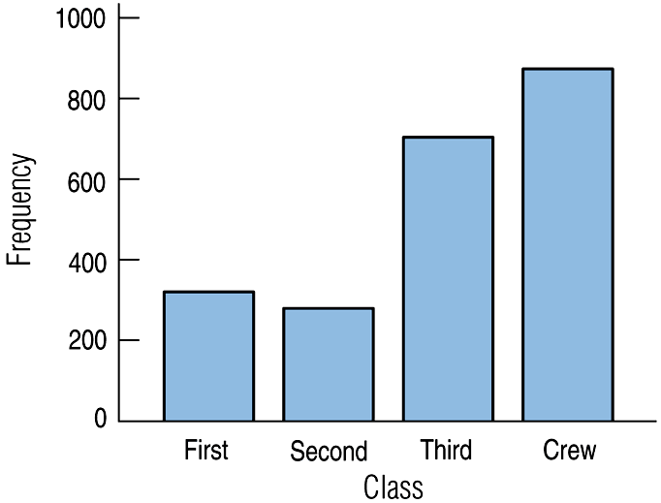
HISTOGRAM vs BAR GRAPHS
HISTOGRAMS are for NUMERICAL data
BAR GRAPHS are for CATEGORICAL data

Slide 8
Spread (min & max values OR IQR OR standard deviation)
CUSS and BS
(describing numerical distributions)
Center (locations of modes OR mean OR median)
Unusual Features (gaps and/or possible outliers)
Shape (unimodal? bimodal? symmetric? skewed? uniform?)
and Be Specific!
(use numerical values when possible)

Slide 9
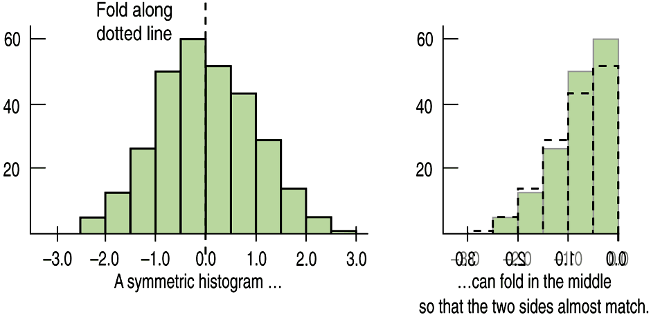
Shape
Is the histogram symmetric?
ALWAYS say “approximately symmetric” or “roughly symmetric”
(unless it truly is perfectly symmetric)

Slide 10
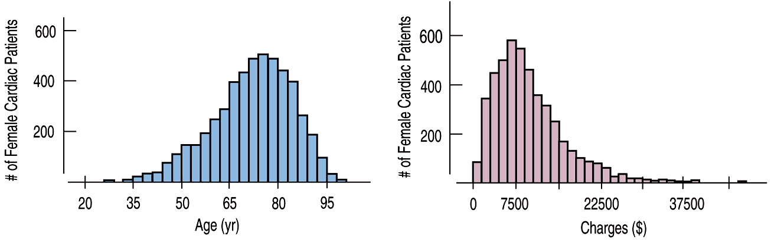
Skewed to the left/right
The thinner ends of a distribution are called tails.
Skewed to the LEFT
Skewed to the RIGHT
(to the lower “numbers”)
(to the higher “numbers”)

Slide 11
THIS IS THE ONLY SITUATION
IN WHICH YOU ARE ALLOWED
TO USE THE WORD “SKEW”!!!
Skewed to the LEFT
Skewed to the RIGHT
(to the lower “numbers”)
(to the higher “numbers”)

Slide 12
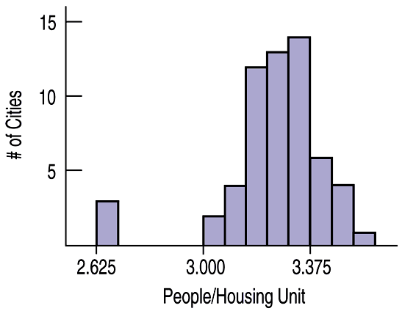
Anything Unusual?
The following histogram has possible outliers—there are three cities in the leftmost bin:
It’s a good idea to say “possible” outliers. Next time we will learn how to test for outliers.

Slide 13
CUSS & BS PRACTICE
(dotplots worksheet)

Slide 14
CUSSing & BS-ing practice
Center: This distribution of quiz scores appears to have two modes, one at around 55, and another at around 80.
Shape: The shape is bimodal, and around each mode the shape is roughly symmetric.
Spread: The spread is from the mid-30’s to the mid-90’s.
Unusual features: There is a gap in the lower 40’s, with a possible outlier in the mid 30’s.

Slide 15
more CUSSing & BS-ing…
Center: This distribution of grades has a single mode at around 100.
Shape: The shape is unimodal and skewed to the left (to the lower grades)
Spread: The spread is from the mid-50’s to about 100.
Unusual features: There is a gap from the upper 50’s to the upper 60’s, with a possible outlier in the mid 50’s.
this does NOT mean that someone had a grade of above 100.
(more likely, a lot of 98’s and/or 99’s)

Slide 16
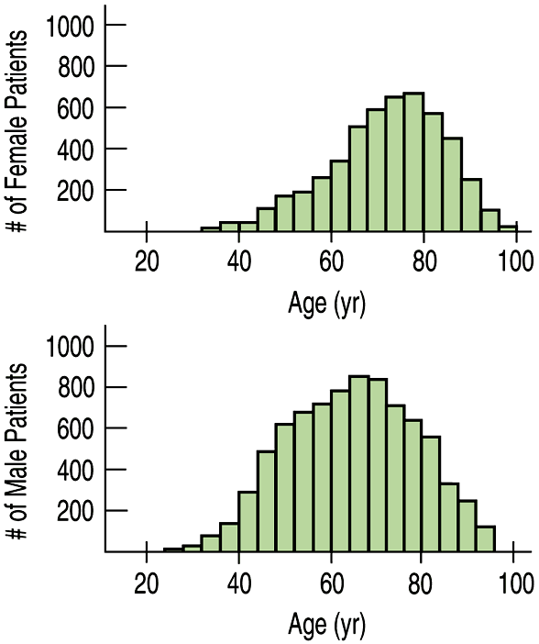
Comparing Distributions
Compare the following distributions of ages for female and male heart attack patients.

Slide 17
Comparing Distributions
Be sure to use language of comparison.
Center: This distribution of ages for females has a higher center (at around 78) than the distribution for male patients (around 62).
Shape: Both distributions are unimodal. The distribution for males is nearly symmetric, while the distribution for females is slightly skewed to the lower ages.

Slide 18
Comparing Distributions
Spread: Both distributions have similar spreads: females from around 30 – 100, and males from about 24 – 96. Overall, the distribution for female ages is slightly higher than that for male ages.
(There are no unusual features)
YOU MUST USE COMPLETE SENTENCES!!!

Slide 19
STEM PLOTS (U.S. Presidents)

Slide 20
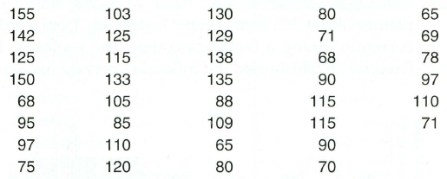
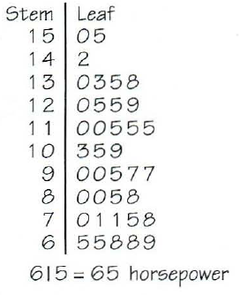
Horsepower of cars reviewed by Consumer Reports:
(not always necessary to use split stems)

Slide 21
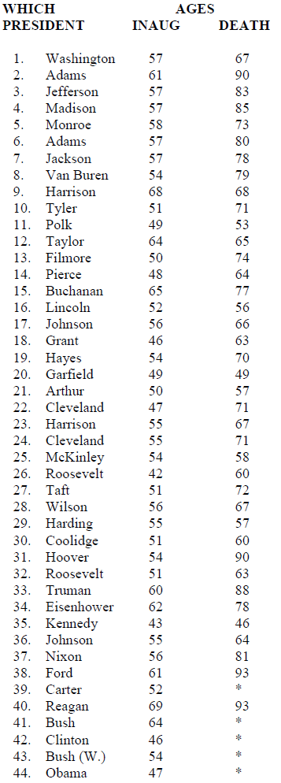
U.S. Presidents – Stem & Leaf Plot
Make a stem & leaf plot of age of…

Slide 22
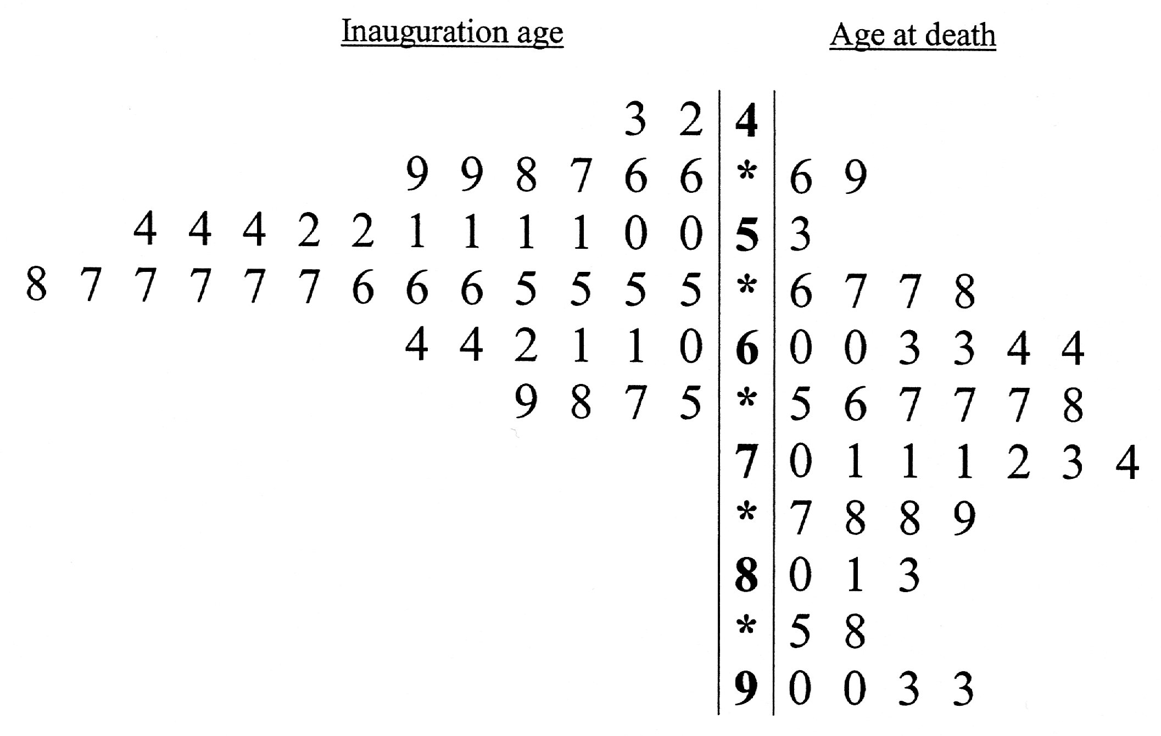
U.S. Presidents
(looks like a histogram!)

Slide 23
U.S. Presidents
means
age 43 at inauguration
age 46 at death

Slide 24
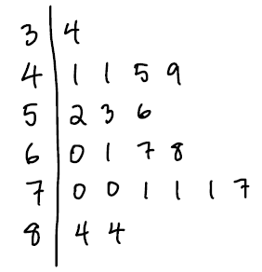
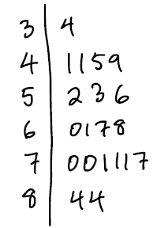
Use stemplots for small to fairly moderate sizes of data (25 – 100)
Try to use graph paper (or make sure that your numbers line up)
(this is okay…)
(this is NOT)

