Slide 1
BOXPLOTS and more numerical distributions
(you’ll want a calculator today!)
chapter 5

Slide 2
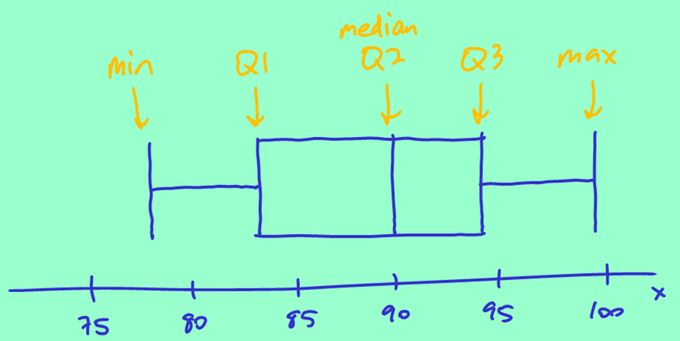
Building a boxplot (if there are NO outliers)
5 number summary:
Min: 77
Q1: 83
Median: 90
Q3: 94
Max: 99

Slide 3
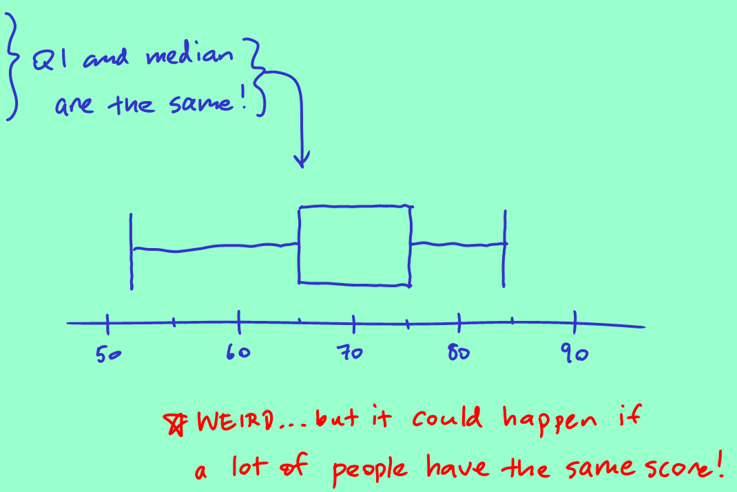
Building a boxplot (a slightly weird one…)
5 number summary:
Min: 52
Q1: 65
Median: 65
Q3: 75
Max: 84

Slide 4
Math Test Scores
(don’t worry, they’re not yours!)
89 67 82 78 58 86 74 77
73 59 78 63 22 6 44 91
Here they are in order, to save us some time:
6 22 44 58 59 63 67 73 74 77 78 78 82 86 89 91

Slide 5
Five number summary
6 22 44 58 59 63 67 73 74 77 78 78 82 86 89 91
5 number summary:
Min: 6
Q1: 58.5
Median: 73.5
Q3: 80
Max: 91

Slide 6
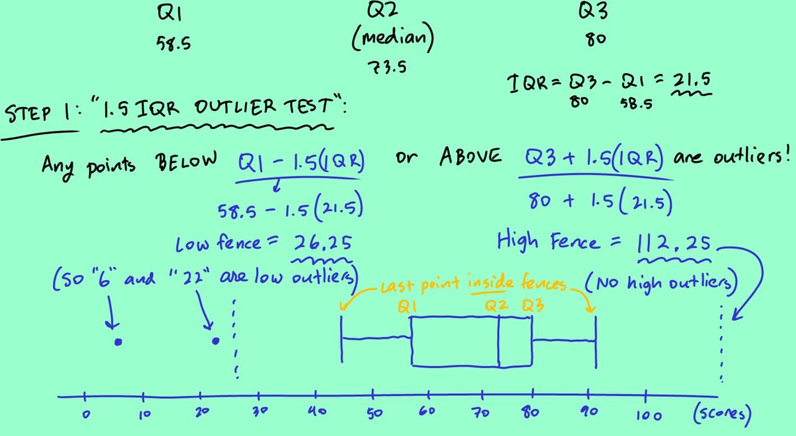
Building a boxplot (and identifying outliers)
6 22 44 58 59 63 67 73 74 77 78 78 82 86 89 91

Slide 7
Wayne Gretzky (the Great One)
This is the distribution for the number of games he played in each of his 20 seasons in the National Hockey League.
Median: (20 + 1)/2 ^{th} value…
So between the 10th and 11th values.
10 values in each half…
Q1/Q3: (10 + 1)/2 ^{th} value…
Q1 is between 5th and 6th values from the bottom,
Q3 is between 5th and 6th values from the top.

Slide 8
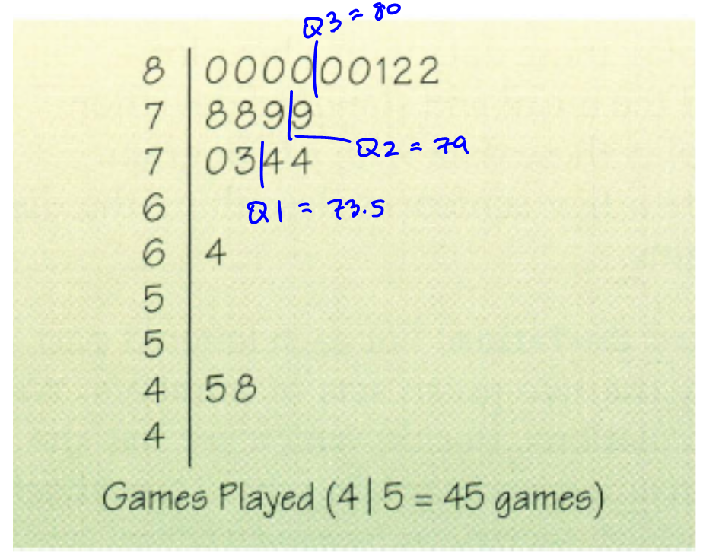
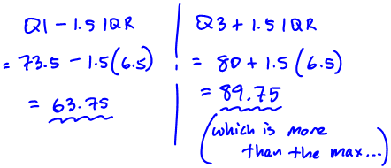
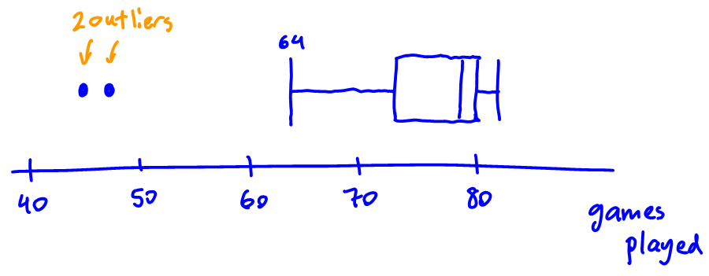
Wayne Gretzky (the Great One)
This is the distribution for the number of games he played in each of his 20 seasons in the National Hockey League.

Slide 9
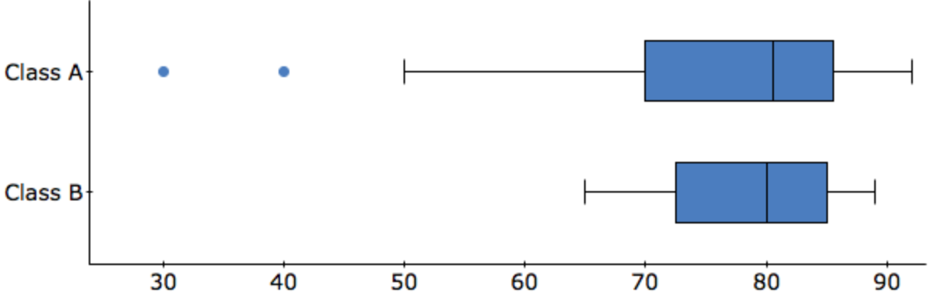
Comparing two boxplots (CUSS/BS)
Two Algebra II classes took the same exam. Write a few sentences comparing the distributions of test scores for the classes.

Slide 10
Two Algebra II classes took the same exam. Write a few sentences comparing the distributions of test scores for the classes.
Center (compare the MEDIANS!):
The two classes have similar medians – about 81 for class A, and 80 for class B.
Spread (either compare min/max OR IQRs):
Class A has a much more variability, with scores going from 30 to about 92 (range of about 62), while class B’s scores only go from 64 to 89 (range of about 25).
Shape:
Class A’s distribution of scores looks skewed to the left, while class B’s distribution almost looks roughly symmetric.
Outliers: Class A has 2 low outliers at 30 and 40. There are no outliers in class B.
DO NOT CALL A BOXPLOT “UNIMODAL” OR “ROUGHLY NORMAL” – we CANNOT see the “modes” in a boxplot!

Slide 11
DISADVANTAGES OF BOXPLOTS
do not retain the individual observations
cannot see gaps
cannot see unimodal vs bimodal vs uniform

Slide 12





Symmetrical boxplots
Approximately symmetrical boxplot
Skewed boxplot

Slide 13
Dispersion Statistics
Group A
65
66
67
68
71
73
74
77
77
77
Group B
42
54
58
62
67
77
77
85
93
100
mean = 71.5
median = 72.0
mode = 77
mean = 71.5
median = 72.0
mode = 77

Slide 14
Standard Deviation Formula
Standard deviation:
without the square root, you have s²,
which is called “variance”,
which is also a measure of spread.

Slide 15
Standard Deviation:
Average (almost) distance from the mean
(let’s do an easy one first)
example
2
5
6
8
14

Slide 16
Standard Deviation:
Average (almost)
distance from the mean
(which group has a larger standard deviation?)
Group A
65
66
67
68
71
73
74
77
77
77
Group B
42
54
58
62
67
77
77
85
93
100

Slide 17
(ONTO YOUR OWN NOTES)

Slide 18
MEAN vs MEDIAN
WHAT IS CONSIDERED “AVERAGE”?

Slide 19
Ken and Barbie go HOUSE SHOPPING!
Here are the prices of some houses in one neighborhood:
$400
$450
$500
$500
$500
$550
$650
Mean: $507.¹⁴ Median: $500
Mean: $2394.⁴⁴
Median: $500
$8,000
$10,000

Slide 20
FOR A DISTRIBUTION THAT IS SKEWED
(OR WITH OUTLIERS):
The median is a
BETTER MEASURE OF CENTER
than the mean.

Slide 21

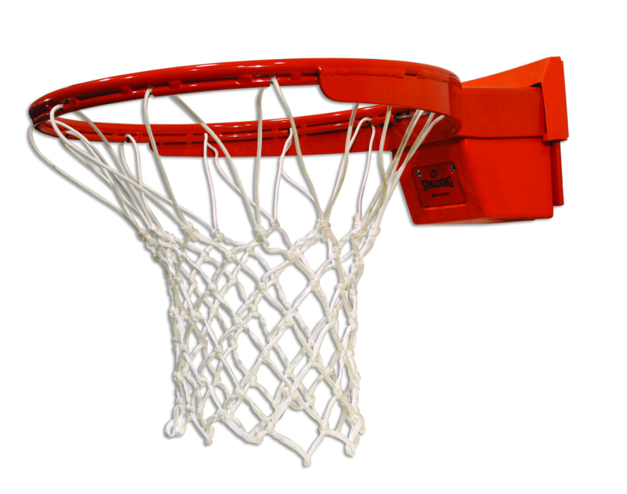
Well, that’s mean!
In the 1980’s the average salary for students who had majored in Cultural Geography at UNC was over $100,000.
At most other colleges the average was around $20,000.

Slide 22
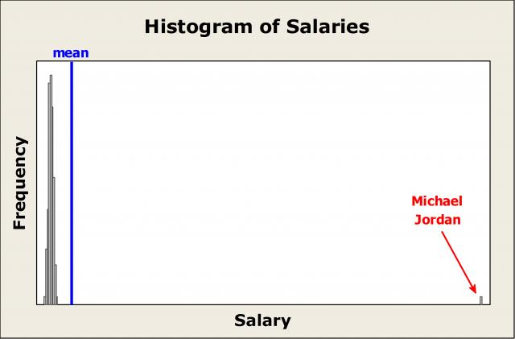

Slide 23
ST. DEV vs IQR

Slide 24
Back to Ken and Barbie’s dollhouse…
$400
$450
$500
$500
$500
$550
$650
St.Dev: $78.⁶⁸ IQR: $100*
$78.⁶⁸ is the typical distance from the mean house price for the houses in this neighborhood.
St.Dev: $3778.⁸⁴
IQR: $150
$8,000
$10,000

Slide 25
FOR A DISTRIBUTION THAT IS SKEWED
(or has outliers):
The IQR is a
BETTER MEASURE OF SPREAD
than standard deviation
or range.

Slide 26
DISTRIBUTION IS… | FOR CENTER, USE: | FOR SPREAD, USE:
ROUGHLY SYMMETRIC | mean OR median | standard deviation OR IQR
SKEWED (OR HAS OUTLIERS) | median | IQR

Slide 27
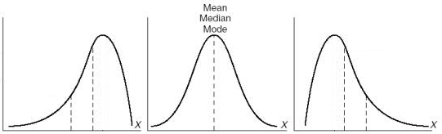
Mean, Median, and Skewness
Mean
Median
Median
Median
Mean
Mean
Balancing Point? (mean)

Slide 28
Comparing standard deviations
(typical or “average-ish” distance from the mean)
X
20
50
80
Y
20
50
80
Z
20
50
80

Slide 29
fin

