Slide 1
Standardized scores and the Normal Model
You will want a calculator for the notes!
Chapter 6

Slide 2
standardizing with z-scores

Slide 3
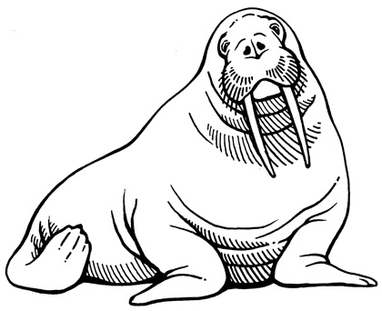
Walrus weights
The mean weight for an adult male walrus is 1215 kg, with a standard deviation of 82 kg.
Chuck (pictured here) weighs 1321 kg. Find Chuck’s standardized score (z-score), then interpret this in context.

Slide 4
Standardizing with z-scores
or “exp”
We call the resulting values
standardized scores, or z-scores.

Slide 5
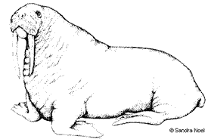
more walrus weights
The mean weight for an adult FEMALE walrus is 812 kg, with a standard deviation of 67 kg.
Delilah weighs 680 kg (she’s been watching her figure!). Find Delilah’s standardized score (z-score), then interpret this in context.

Slide 6
comparing walrus weights…
Based on the z-scores that we calculated, who’s weight is MORE UNUSUAL for their gender – Chuck or Delilah?
z = 1.29
z = -1.97

Slide 7
In an AP Comic Design class…
Melody scored 84 on a test where the class
mean = 80 and a standard deviation of 4.
Josh scored 90 on another test where the
mean = 87 with a standard deviation of 3.
Who scored better relative to the other students in their AP Comic Design class?

Slide 8
the Normal Model
(back to your own notes ☺)

Slide 9
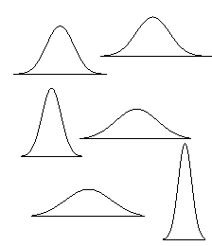
There is a model that shows up over and over in Statistics, called the
Normal model

Slide 10
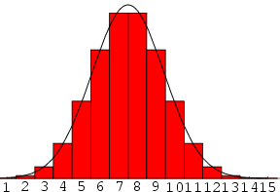
We use the Normal model to APPROXIMATE
actual distributions
that are unimodal
and roughly
symmetric.
(it’s not exact)

Slide 11

Adult FEMALE walrus weights are APPROXIMATELY NORMALLY DISTRIBUTED, with a mean of 812 kg, and a standard deviation of 67 kg.
Draw the Normal model for these female weights.

Slide 12
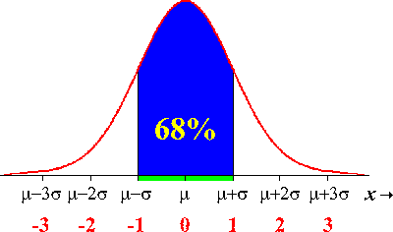
68% of observations fall within 1σ of μ

Slide 13
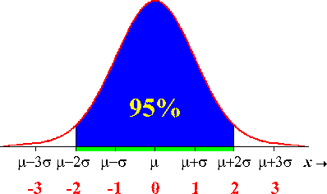
95% of observations fall within 2σ of μ

Slide 14
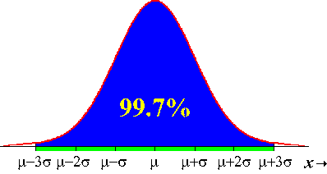
99.7% of observations fall within 3σ of μ

Slide 15
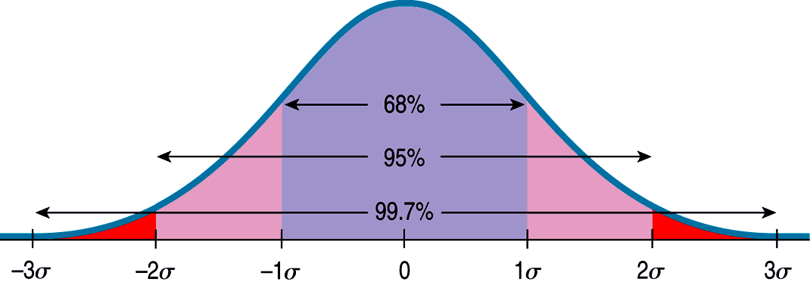
The Rule
68-95-99.7
(a.k.a. “the empirical rule”)

Slide 16
Adult FEMALE walrus weights are approximately normally distributed, with a mean of 812 kg, and a standard deviation of 67 kg.
What proportion of walrus weights is…
between 812 and 879 kg?

Slide 17
Adult FEMALE walrus weights are approximately normally distributed, with a mean of 812 kg, and a standard deviation of 67 kg.
What proportion of walrus weights is…
b) less than 879 kg?

Slide 18
Adult FEMALE walrus weights are approximately normally distributed, with a mean of 812 kg, and a standard deviation of 67 kg.
What proportion of walrus weights is…
c) between 745 and 946kg?
d) greater than 946kg?
e) less than 611kg?

Slide 19
Adult FEMALE walrus weights are approximately normally distributed, with a mean of 812 kg, and a standard deviation of 67 kg.
What proportion of walrus weights is…
c) between 745 and 946kg?

Slide 20
Adult FEMALE walrus weights are approximately normally distributed, with a mean of 812 kg, and a standard deviation of 67 kg.
What proportion of walrus weights is…
d) greater than 946kg?

Slide 21
Adult FEMALE walrus weights are approximately normally distributed, with a mean of 812 kg, and a standard deviation of 67 kg.
What proportion of walrus weights is…
e) less than 611kg?

Slide 22
Quick facts about the Normal model
The total area under the standard normal curve is 1.0 (or 100%)
In theory, the normal curve extends FOREVER in both directions (the height never reaches zero)

Slide 23
Once we have standardized…
(converted everything into z-scores)
The N(0,1) model is called the
standard Normal model

Slide 24
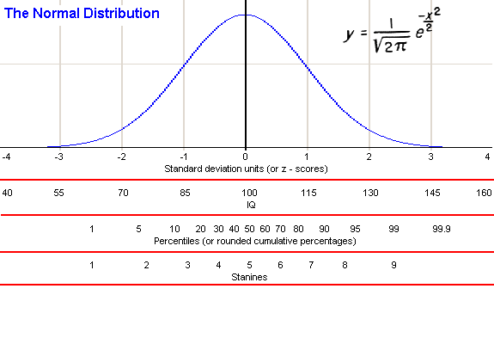
Inflection points

Slide 25
when we can’t use the 68-95-99.7 rule…?

Slide 26

one option is to use CALCULUS…
Gasp!

Slide 27
…take the integral under the curve…

Slide 28
so instead, we’ll use the z-table!

Slide 29
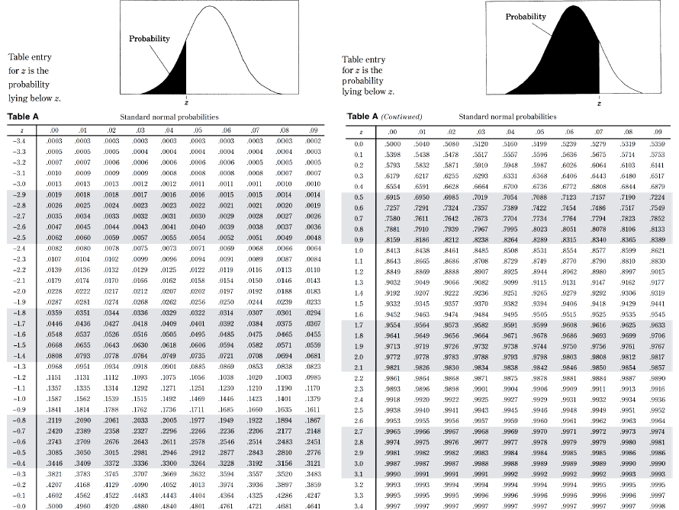

Slide 30
walruses revisited

Slide 31
Adult FEMALE walrus weights are approximately normally distributed, with a mean of 812 kg, and a standard deviation of 67 kg.
If we select an adult female walrus at random, what is the probability that her weight is…
less than 879 kg?
(what about MORE than 879 kg?)
You are expected to communicate your process. Your work and drawings are an important part of that!

Slide 32
Adult FEMALE walrus weights are approximately normally distributed, with a mean of 812 kg, and a standard deviation of 67 kg.
If we select an adult female walrus at random, what is the probability that her weight is…
b) more than 780 kg?
You are expected to communicate your process. Your work and drawings are an important part of that!

Slide 33
Adult FEMALE walrus weights are approximately normally distributed, with a mean of 812 kg, and a standard deviation of 67 kg.
If we select an adult female walrus at random, what is the probability that her weight is…
c) less than 600 kg?
You are expected to communicate your process. Your work and drawings are an important part of that!

Slide 34
Adult FEMALE walrus weights are approximately normally distributed, with a mean of 812 kg, and a standard deviation of 67 kg.
If we select an adult female walrus at random, what is the probability that her weight is…
d) between 700 and 800 kg?
You are expected to communicate your process. Your work and drawings are an important part of that!

Slide 35
Adult FEMALE walrus weights are approximately normally distributed, with a mean of 812 kg, and a standard deviation of 67 kg.
If we select an adult female walrus at random, what is the probability that her weight is…
e) between 720 kg and 785 kg?
You are expected to communicate your process. Your work and drawings are an important part of that!

Slide 36
using the z-table in reverse

Slide 37
(working backwards with the Normal model)
What z-score corresponds with the 60th percentile?
What about the 10th percentile?

Slide 38
Adult FEMALE walrus weights are approximately normally distributed, with a mean of 812 kg, and a standard deviation of 67 kg.
f) Approximately what weight represents the cut-off for the TOP 5% of adult female walrus weights?

Slide 39
Adult FEMALE walrus weights are approximately normally distributed, with a mean of 812 kg, and a standard deviation of 67 kg.
g) Approximately what weight represents the cut-off for the BOTTOM 20% of adult female walrus weights?

Slide 40
Adult FEMALE walrus weights are approximately normally distributed, with a mean of 812 kg, and a standard deviation of 67 kg.
*h) What is the IQR for adult female walrus weights?

Slide 41
Would the Normal model be appropriate for this distribution?
No – to use the Normal model, the distribution should be unimodal and approximately symmetric.

Slide 42
(standardizing DOES NOT change the shape of the distribution)

Slide 43
If a distribution is NOT approximately normal…
We CAN calculate a z-score
(and it still represents a # of SD’s from the MEAN)
We CANNOT use the normal model (or the z-table) to find a probability with that z-score.

Slide 44
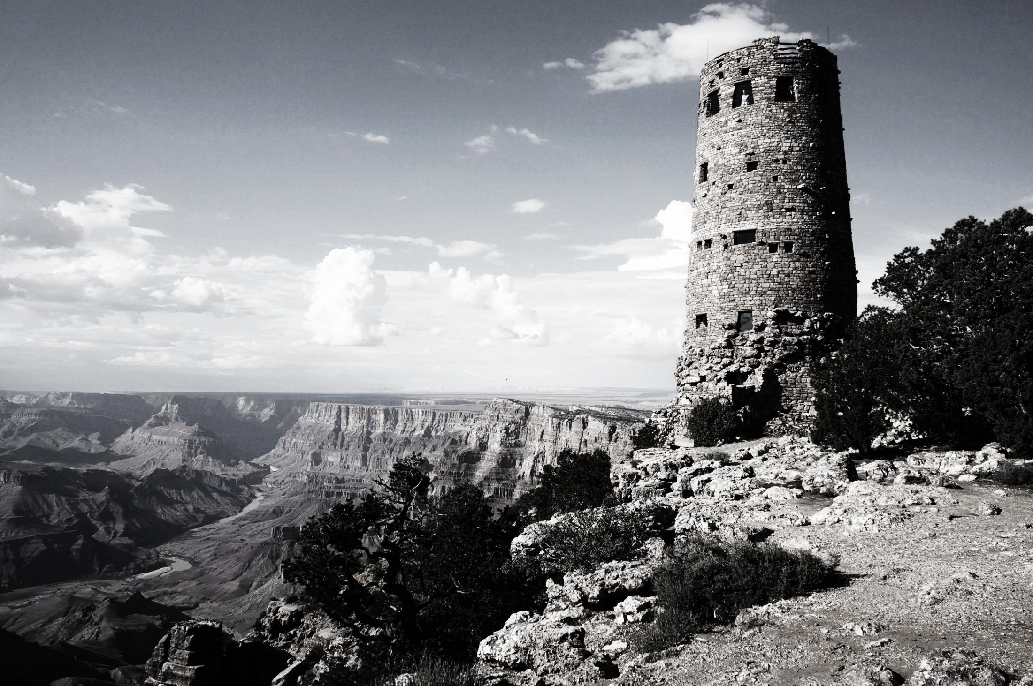

Slide 45
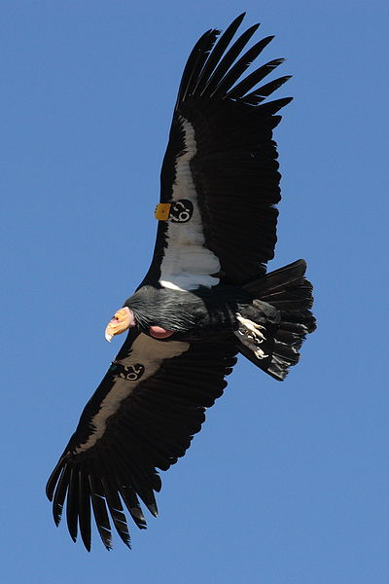
California condors have a mean wingspan of 9.1 feet, with a standard deviation of 0.63 feet.
If the distribution of these wingspans is approximately normal, what is the probability that a randomly selected condor has a wingspan of…
less than 8 feet
at least 9.9 feet
between 8 feet and 10 feet
Find the cut-off (in feet) for the largest 25% of wingspans.
0.0404
0.1021
0.8830
about 9.53 feet

Slide 46
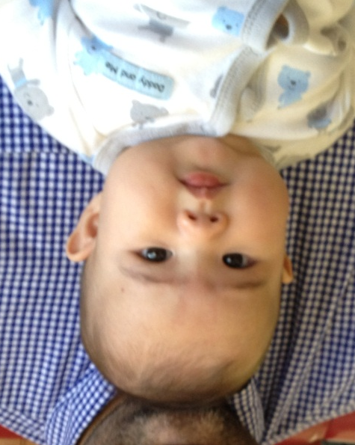
6-month old male babies have a mean weight of 16.5 pounds.
My little nephew weighs 20 pounds, which places him at the 95TH PERCENTILE for babies his age.
What is the standard deviation of weights for male babies at 6 months of age?
(meanwhile he was at the 50TH PERCENTILE for height…)
ANSWER:
about 2.13 pounds

Slide 47
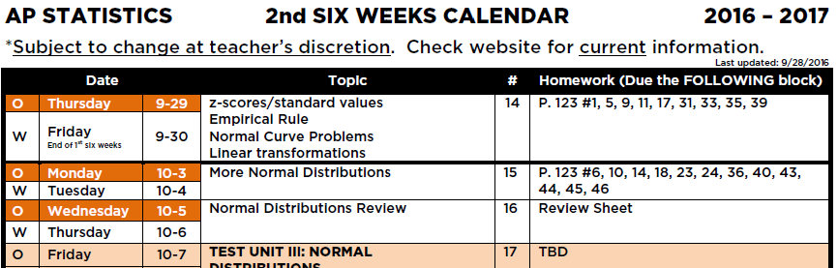
the end
for now…
(homework #14 is VERY IMPORTANT,
and due next time)

