Slide 1
Scatterplots
Association and Correlation
Chapter 7

Slide 2
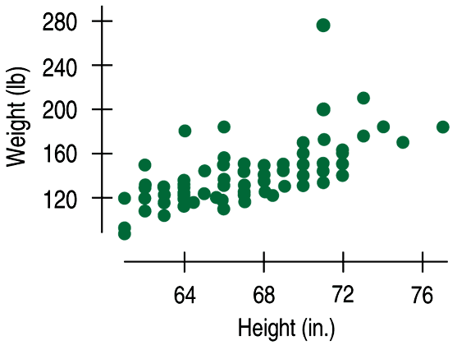
DESCRIBING SCATTERPLOTS
Data collected from students in Statistics classes included their heights (in inches) and weights (in pounds):

Slide 3
DESCRIBING ASSOCIATION
If you are asked to “describe the association” in a scatterplot, you must discuss these three things:
STRENGTH (weak, moderate, strong)
FORM (linear or non-linear)
DIRECTION (positive? negative?)

Slide 4
What type of association do we expect (and what about causation)?
Gas prices at a gas station VS # of visitors to that gas station?

Slide 5
What type of association do we expect (and what about causation)?
Number of daily umbrella sales VS number of car accidents that day

Slide 6
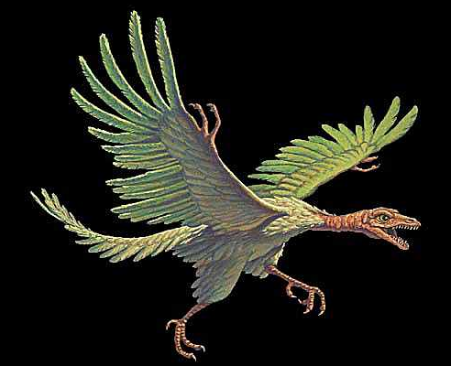
Scatterplots and Regressions

Slide 7
Archaeopteryx is an extinct beast having feathers like a bird but teeth and a long bony tail like a reptile. Only six fossil specimens are known. Because these specimens differ greatly in size, some scientists think they are different species rather than individuals from the same species. If the specimens belong to the same species and differ in size because some are younger than others, there should be a positive linear relationship between the bones from all individuals. An outlier from this relationship would suggest a different species. Here are data on the lengths in centimeters of the femur (a leg bone) and the humerus (a bone in the upper arm) for the five specimens that preserve both bones.
femur | 38 | 56 | 59 | 64 | 74
humerus | 41 | 63 | 70 | 72 | 84
Load data into list 1 and list 2 and make a scatterplot.

Slide 8

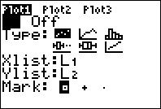

Slide 9
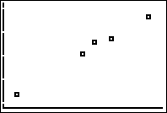
This is not enough. What do we need?

Slide 10
72
humerus length in cm
41
38
64
femur length in cm
A “cheater” way to put scale on a scatterplot is to trace two points and label each axis with those two values.

Slide 11
72
humerus length in cm
41
38
64
femur length in cm
explanatory variable?
femur length in cm
response variable?
humerus length in cm
But does it really matter here?
No. But often it does.

Slide 12
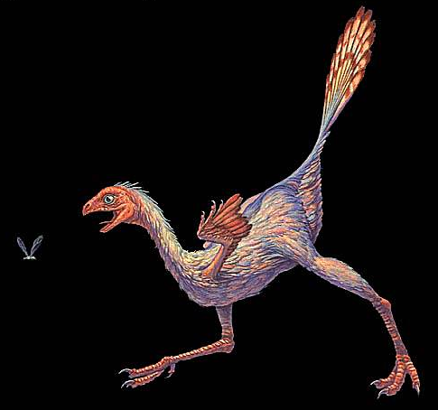
Find the correlation coefficient and explain what it means.

Slide 13
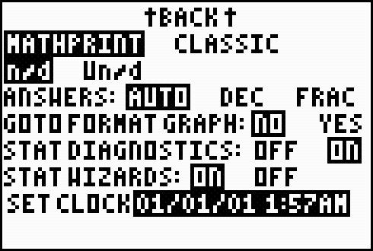
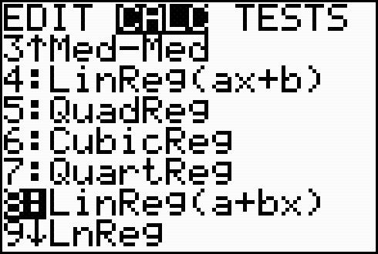
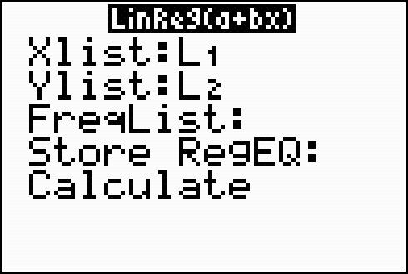
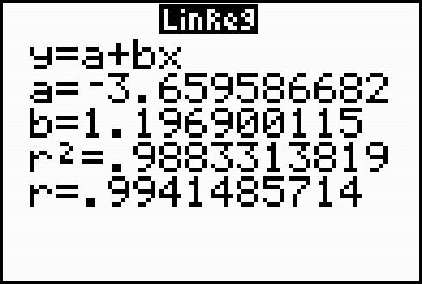

Find the correlation coefficient and interpret in context
correlation coefficient
Did you get it?

Slide 14
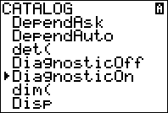
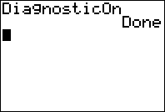
If you did not get the correlation coefficient, you must turn your diagnostics on.
Push 2nd then 0.
Scroll down to diagnostics on.
Push “enter” twice and little calculator guy will say “done”.

Slide 15
DESCRIBING ASSOCIATION
Data collected from students in Statistics classes included their heights (in inches) and weights (in pounds):
Here we see a
moderate, positive
association and
a fairly straight form, although there seems to be a high outlier.

Slide 16
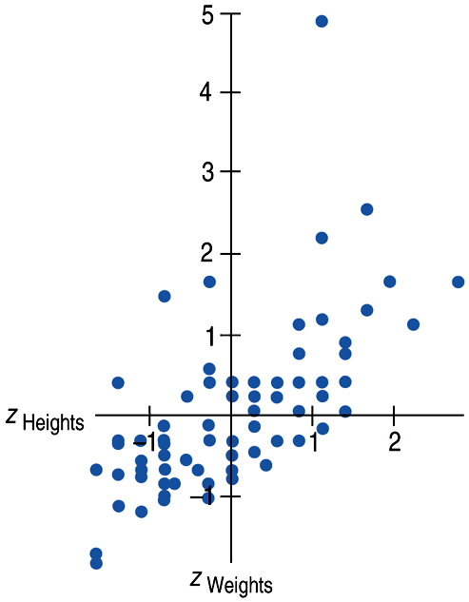
Calculating Correlation…
(don’t worry, you’ll never have to do it by hand)
Since the units don’t matter, why not remove them altogether?
We could standardize both variables and write the coordinates of a point as (z_{x}, z_{y}).
Here is a scatterplot of the standardized weights and heights:

Slide 17

Correlation Coefficient (r)
is calculated by doing a mathematical mash-up of the z-scores for EVERY POINT’S x-coordinate AND y-coordinate. IT’S TEDIOUS.

Slide 18
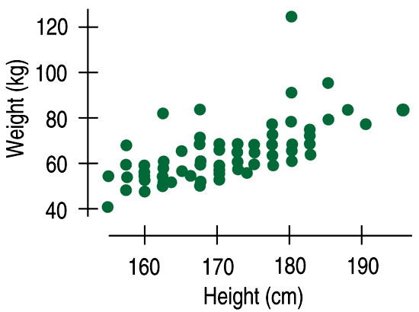
Correlation
does not depend on the units.
SCALING AND SHIFTING DO NOT AFFECT CORRELATION.

Slide 19
Correlation
treats x and y symmetrically.
If we swap x and y,
the correlation does not change.

Slide 20
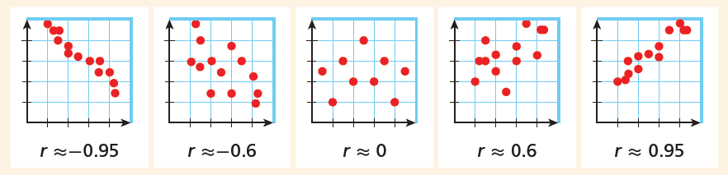
Correlation Coefficient (r)
Correlation is always between -1 and 1.
strong
moderate
weak (or “moderately weak”)

Slide 21

GUESS THE CORRELATION COEFFICIENT
The correlation coefficient describes the strength of the linear relationship. The closer it is to 1 or -1 the more the points line up.
These points line up pretty well with a positive slope.
The correlation coefficient would be close to 0.8 or 0.9.

Slide 22

GUESS THE CORRELATION COEFFICIENT
The correlation coefficient describes the strength of the linear relationship. The closer it is to 1 or -1 the more the points line up.
These points don’t line up at all.
The correlation coefficient would be nearly 0.

Slide 23

GUESS THE CORRELATION COEFFICIENT
The correlation coefficient describes the strength of the linear relationship. The closer it is to 1 or -1 the more the points line up.
These points line up sort of well with a negative slope.
The correlation coefficient might be – 0.6 or – 0.7.

Slide 24

GUESS THE CORRELATION COEFFICIENT
The correlation coefficient describes the strength of the linear relationship. The closer it is to 1 or -1 the more the points line up.
These points don’t line up at all.
The correlation coefficient would be fairly close to 0.

Slide 25
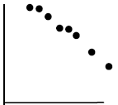
GUESS THE CORRELATION COEFFICIENT
The correlation coefficient describes the strength of the linear relationship. The closer it is to 1 or -1 the more the points line up.
These points line up pretty well with a negative slope.
The correlation coefficient would be around -0.99.
(very close to -1)

Slide 26

r = .994 Here’s what you write:
This suggests a strong, positive, linear relationship between femur length and humerus length.

Slide 27
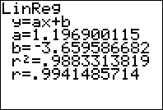

So what’s the rest of this stuff?

Slide 28
slope
y-intercept
coefficient of determination
equation: ŷ = 1.197x – 3.660
This is hugely important! It means
the predicted y.

Slide 29
LSRL equation: ŷ = 1.197x – 3.660
where x = femur length and y = humerus length
slope = 1.197; For every 1 cm increase in femur length, the model predicts an increase in humerus length of 1.197 cm.
y-intercept ; When the femur length is 0 cm, the humerus length is predicted to be about -3.660 cm.
(Of course, this is ridiculous… an example of extrapolation)

Slide 30
Residuals
Since our line misses many of the points, a residual is a measure of the “miss.”
residual = y – ŷ (actual – predicted)
a residual is the vertical distance from the point to the line

Slide 31
What is the residual for the point (56, 63)?
residual (e) = y – ŷ
ŷ = 1.197x – 3.660
ŷ = 1.197(56) – 3.660 = 63.372
residual = y – ŷ = 63 – 63.372 = -0.372
This specimen has a humerus length that is 0.372 cm LESS THAN what the model predicts based on its femur length.

Slide 32
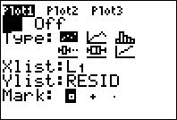
A residual plot is a graph of all the residuals.
To get resid, push
2nd
stat
resid
This only works if the calculator knows the equation of the line.

Slide 33
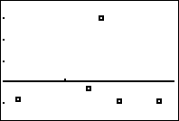
Residual Plot
3
residuals
-.8
38
59
femur length in cm
This is a… decent residual plot. We’d like the points to be equally scattered above and below the line.

Slide 34
Let’s interpret the r-squared value…
coefficient of determination
About 98.8% of the variability in “y” can be explained by the linear model for “x” and “y”…
(but replace “x” and “y” with context!)

Slide 35
CORRELATION
measures the strength of the
LINEAR association
between two QUANTITATIVE variables.
is UNIT-LESS.
is SENSITIVE TO OUTLIERS
(since correlation is calculated from z-scores – which are based on means and standard deviations)

Slide 36
Correlation is very sensitive to outliers.
The correlation between shoe size and IQ is surprisingly strong.
(what?!??!)
r = 0.40
r = -0.005!!

Slide 37
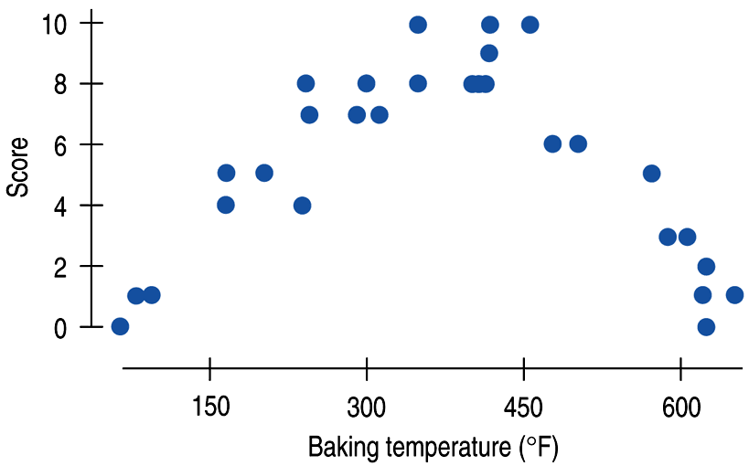
Correlation measures the strength of
a linear relation only.
This graph has a STRONG association…
but close to a zero correlation since the association is non-linear.

Slide 38
(what’s wrong?)
There is a high correlation between the gender of American workers and their income.
Gender of American workers is categorical, not quantitative.

Slide 39
(what’s wrong?)
“We found a high correlation (r = 1.09) between students’ ratings of faculty teaching and ratings made by other faculty members.”
“The correlation between planting rate and yield of corn was found to be r = 0.23 bushels.”

Slide 40
The following tables summarize sample data collected from two different regions regarding the types of television programs that people prefer watching in their free time:
REGION A:
REGION B:
 | Football | TV Drama | Some dancing TV show…
FEMALE | 25 | 30 | 40
MALE | 25 | 30 | 40
 | Football | TV Drama | Some dancing TV show…
FEMALE | 5 | 30 | 60
MALE | 55 | 30 | 10
In which region is there a stronger CORRELATION between PREFERRED TV PROGRAM and GENDER?
ASSOCIATION

Slide 41
In which region is there an ASSOCIATION between PREFERRED TV PROGRAM and GENDER?
REGION A:
REGION B:
 | Football | TV Drama | Some dancing TV show…
FEMALE | 25 | 30 | 40
MALE | 25 | 30 | 40
 | Football | TV Drama | Some dancing TV show…
FEMALE | 5 | 30 | 60
MALE | 55 | 30 | 10
NO ASSOCIATION between TV program and gender means that the distributions for males and females ARE THE SAME.
If there IS AN ASSOCIATION between TV program and gender, then the distributions for males and females ARE DIFFERENT.

Slide 42
IF DESCRIBING THE RELATIONSHIP BETWEEN CATEGORICAL VARIABLES, USE THE WORD
ASSOCIATION
(AND NOT CORRELATION)
(“CORRELATION” IS A VERY SPECIAL TYPE OF ASSOCIATION)

Slide 43
This is data from 27 students’ test scores on two different exams.
TEST UNIT 4 (PROBABILITY)
TEST UNIT 1 (DESIGNING STUDIES)

Slide 44
Fin

