Slide 1
the Normal Model chapter 6 (part deux)
The following problems may be challenging, so take good notes and put on your game faces…

Slide 2
You are given the mean, standard deviation, and max value of a distribution.
Would the normal model be appropriate for this distribution? Explain.
Mean | Std. Dev | Max
89 | 8.4 | 95
In a normal distribution, we expect the max value to be at least 2 standard deviations above the mean. In this case, the max is less than one standard deviation above the mean, which suggests that this distribution is skewed to the left (lower numbers). The Normal model would NOT be appropriate for this distribution.

Slide 3
Scores on the math section of the PSAT (the Podunk SAT) are approximately normally distributed.
A score of 674 is at the 90th percentile, while a score of 544 is at the 30th percentile.
Calculate the parameters for this distribution of scores (find µ and σ).
Answer: mean = 582, st. dev = 72 (about)

Slide 4
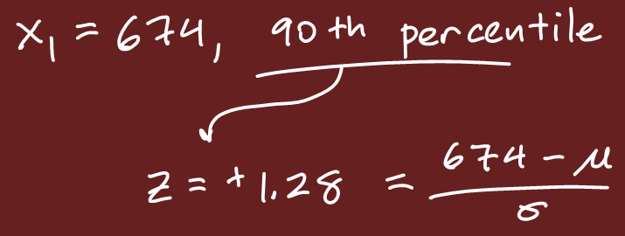
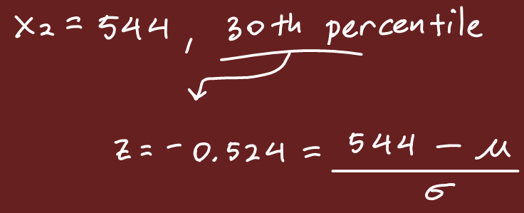
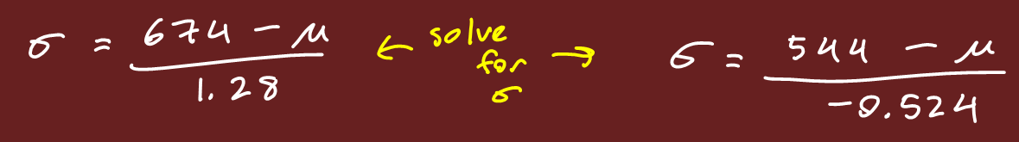
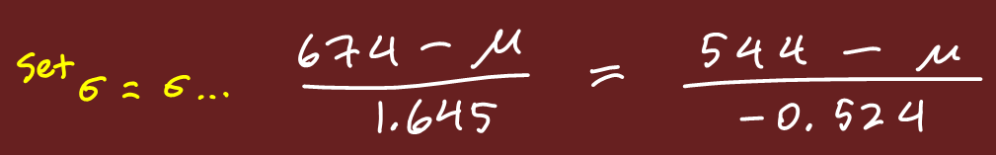
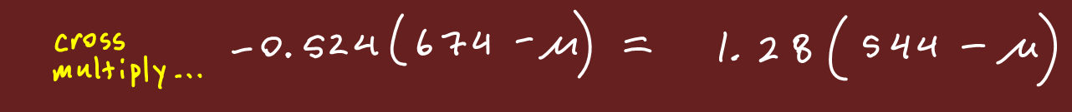



Slide 5
While only 5% of babies have learned to walk by the age of 10 months, 75% are walking by 13 months of age. If the age at which babies develop the ability to walk can be described by a Normal model, find the parameters (mean and standard deviation).
Answer: mean = 12.127 months, st. dev = 1.293 months

Slide 6
Two classes took a difficult physics test. When looking at the histograms of the test scores, each class’ distribution is unimodal.
In class “P”, the scores were skewed to the left.
However, in class “V”, the scores were skewed to the right.
In which class did a larger proportion of students score above the mean score for their class?
Answer: Class “P” – the mean is less than the median, and the median is the 50th percentile…

Slide 7
On the next physics test, both classes had a score distribution that was approximately normally distributed.
However, in class “V”, the mean score was 50, and the range was 20.
In class “P”, the mean score was 70, and the range was also 20.
If both class’ scores were combined into a single distribution, what would be the shape of the combined distribution of test scores?
(scores varied from 40 to 60)
(scores varied from 60 to 80)
Answer: Bimodal!!!

Slide 8
Finally, on the third physics test, class “P” had a score distribution that was perfectly symmetric. (class “V” has disbanded by this point…) Which of the following statements must be true?
The distribution of scores is roughly normal
The distribution of scores is uniform
The distribution of scores is bimodal
The mean is equal to the median
Answer: Only “IV”

Slide 9
Men’s shirt sizes are determined by their neck sizes. Suppose that men’s neck sizes are normally distributed with mean 15.8 inches and standard deviation 0.7 inches. Here is a table with the sizes:
M | 15 to 16 inches
L | 16 to 17 inches
XL | 17 to 18 inches
Find the proportion of men whose shirt size is “L”.
Find the proportion of men whose neck size is too large to fit into a size “M”.
This store ONLY sells shirts in the three sizes listed above. What proportion of men would not be able to get a shirt that fits their neck size?

Slide 10
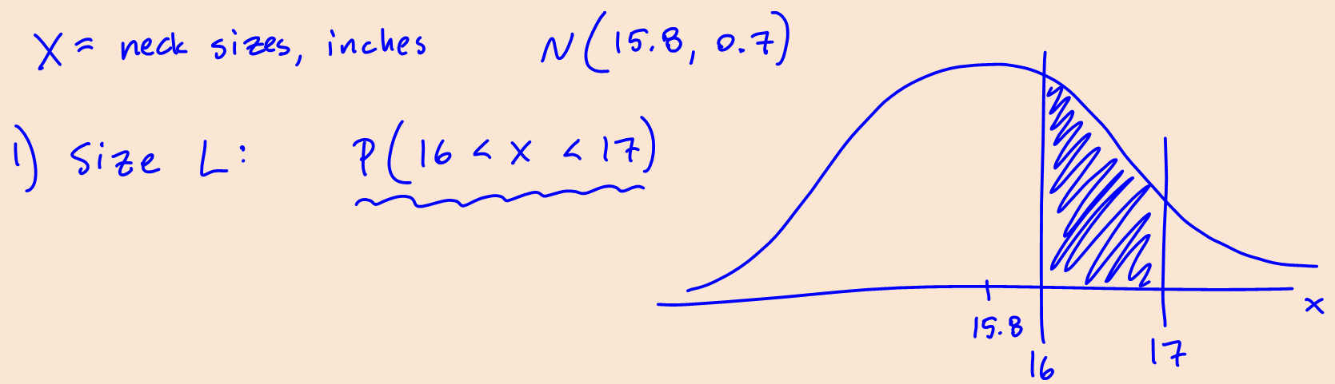
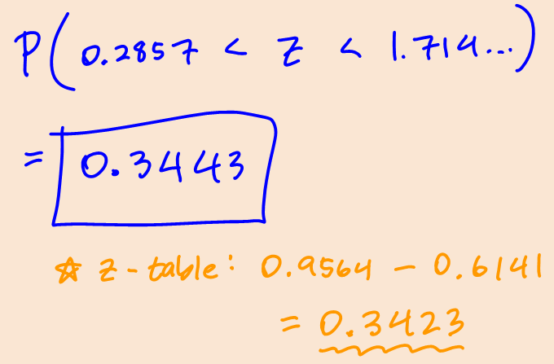
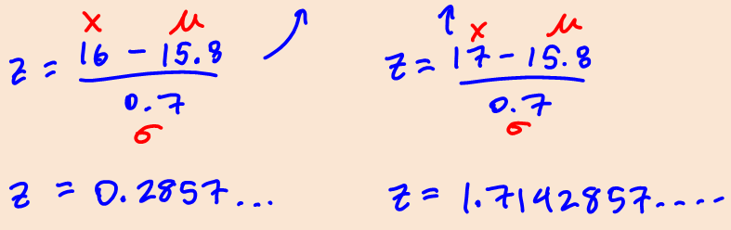
Find the proportion of men whose shirt size is “L”.

Slide 11
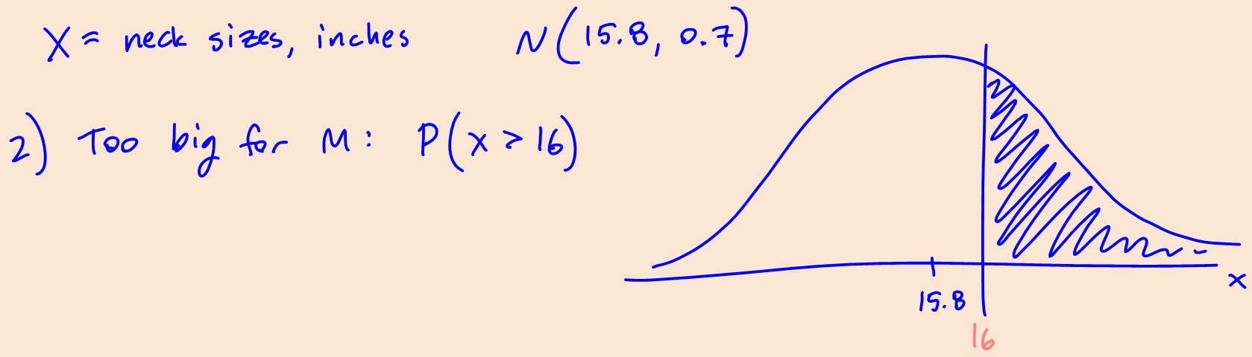
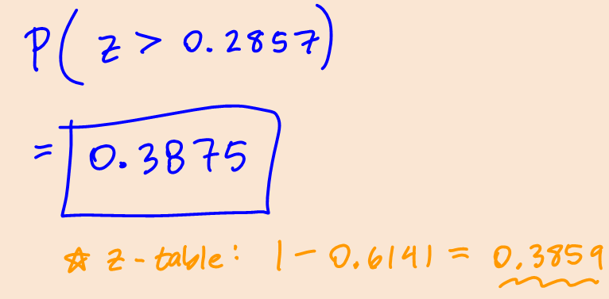
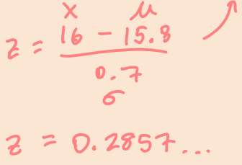
Find the proportion of men whose neck size is too large to fit into a size “M”.

Slide 12
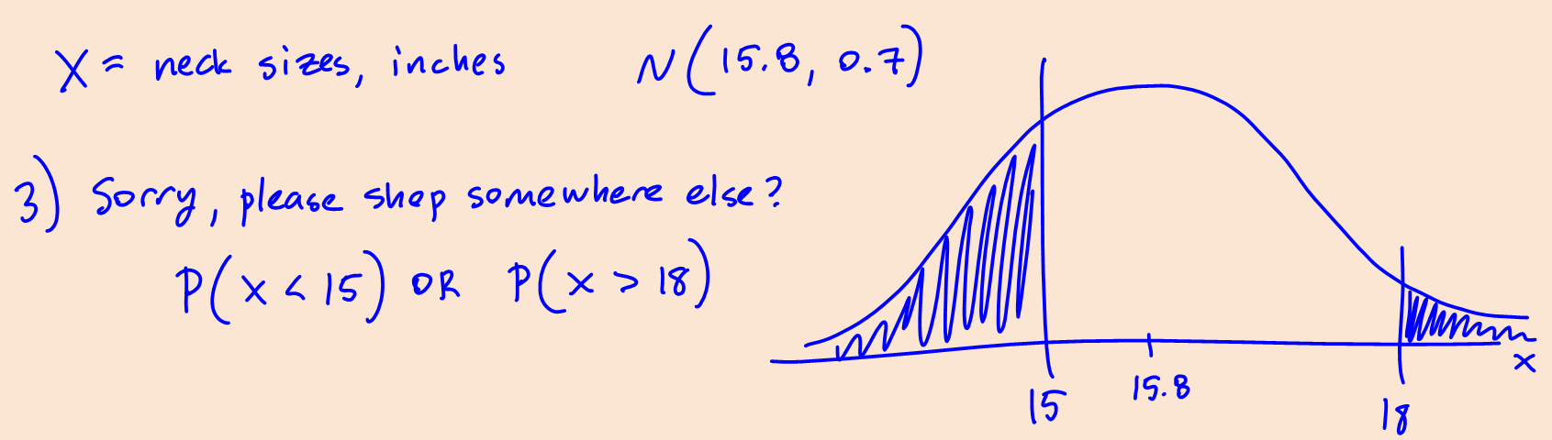
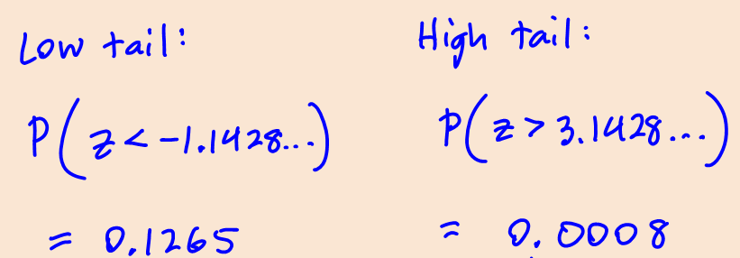
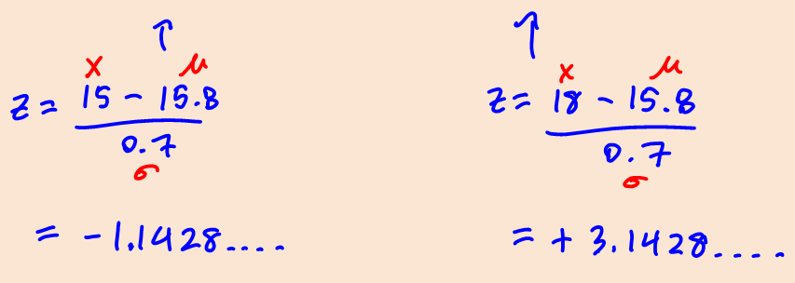
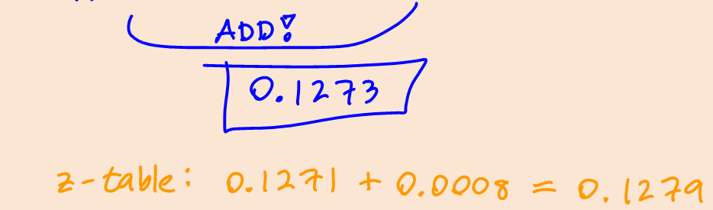
This store ONLY sells shirts in the three sizes listed above. What proportion of men would not be able to get a shirt that fits their neck size?

Slide 13
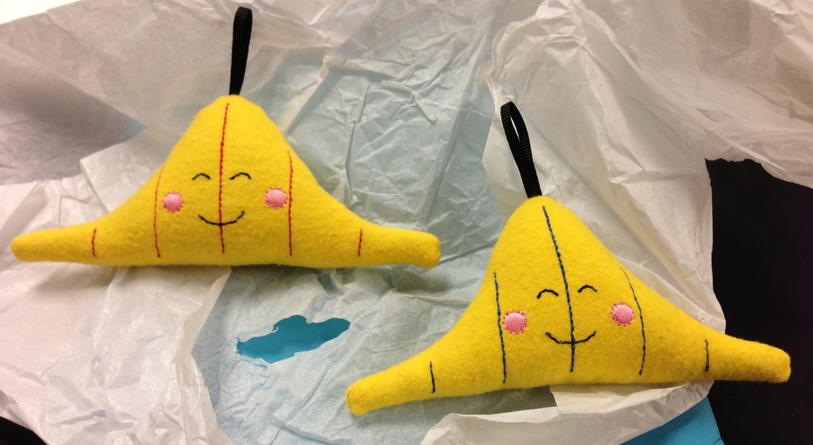
Fin TEST NEXT BLOCK!

