Slide 1
Random Sampling
[notes for days 2 and 3]
All statistical sampling designs have in common the idea that
chance
not human choice
is used to select the sample.

Slide 2
Randomize – let chance do the choosing!
Randomization can protect you against
-factors that you know are in the data
-factors you are not even aware of
Randomizing makes sure that
on the average
the sample looks like the population.

Slide 3
Summary of Sampling Methods
Simple Random Sampling (SRS)
every individual has an equal chance of being selected
every set of n individuals has an equal chance of being selected
*most basic & fundamental type of sampling!

Slide 4
Describe how to select a SRS of 5 students from a group of 27:
Assign each student a unique number from 1 – 27
Use a RNG (on a calculator/computer) to generate 5 UNIQUE numbers from 1 – 27 (repeated numbers will be ignored).
The 5 students who have their numbers drawn will…
OR
Assign each student a unique number from 1 – 27
Write the numbers 1 – 27 on slips of paper, and put them in a hat. Stir the slips to mix them.
Without looking, draw 5 slips of paper from the hat WITHOUT REPLACEMENT.
The 5 students who have their numbers drawn will…

Slide 5
Summary of Sampling Methods
Stratified Sampling
divide population into strata (layers, subpopulations)
Strata are homogenous
take SRS from each strata
Cluster sampling
divide population into clusters
Clusters are heterogenous (mixed)
Randomly select one (or more) cluster(s)
Take a CENSUS within cluster(s)

Slide 6
Summary of Sampling Methods
Systematic Sampling
Randomly select a starting point, then take (for example) every 10th (or 20th, or 5th, etc.) subject...
Multistage Sampling
Randomness is involved at more than one stage
Be careful not to confuse with CLUSTER sampling

Slide 7
bias ≠ error
Bias: Something that causes your measurements to systematically miss in the same direction every time. This is bad.
Sampling “error” is just sampling variation. (If you flip a coin 10 times, you won’t ALWAYS get 5 heads & 5 tails… some variation is inevitable with randomness)

Slide 8
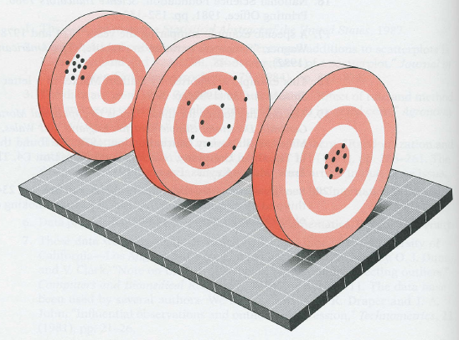

Slide 9
(a)
(b)
(c)
(d)

Slide 10
so if samples are prone to sampling error,
why not conduct a census EVERY TIME?
Taking a CENSUS of the population is (usually) time-consuming and (often) error-prone

Slide 11
Types of data – Numerical vs Categorical
Numerical: Does it make sense to take an average?
Catergorical: Cannot take an average, but we CAN take a proportion (or percentage) of…
Name | Job Type | Age | Gender | Race | Salary | Zip Code
Jose Cedillo | Technical | 27 | Male | Hispanic | 52,300 | 90630
Amanda Childers | Clerical | 42 | Female | White | 27,500 | 90521
Tonia Chen | Management | 51 | Female | Asian | 83,600 | 90629

Slide 12
A research group wishes to know the mean GPA of all 2600(ish) students at Podunk High School. To estimate this, they take a random sample of 189 students that are enrolled in Pre-AP/AP math classes, and pull those records. The mean GPA of the students in the sample is 3.38. According to the school registrar, the GPA of all 2600(ish) students at Podunk High School is 3.09.
Identify the following
Population (of interest):
Parameter of interest:
Sampling frame:
Sample:
(WHO are we interested in?)
ALL students at PHS
(WHAT are we interested in?)
Mean GPA of ALL students at PHS
(who had a CHANCE of being selected?)
All students enrolled in Pre-AP/AP Math
(who was actually selected?)
The 189 students.
GPA is numerical data:
3.09 – this number is the PARAMETER (refers to the population)
3.38 – this number is the STATISTIC (refers to the sample)

Slide 13
A neighborhood interest group wants to know what proportion of households in Austin watch the TV show “Dancing with the Comets.” They select a random sample of 59 houses from Northwest Austin, and find that 35.6% of those families watch the program regularly. Local ratings indicate that about 22% of all households watch “Dancing with the Comets” on a regular basis.
Identify the following
Population (of interest):
Parameter of interest:
Sampling frame:
Sample:
Households in Austin (probably ALL of Austin)
What proportion of households in Austin watch “DWTC”
Households in Northwest Austin
The 59 houses that were selected.
This is categorical data (think: The answer is Yes/No.
22% or 0.22 – this number is the PARAMETER (refers to the population)
35.6% or 0.356 – this number is the STATISTIC (refers to the sample)

Slide 14
Parameters vs. Statistics
(population)
(sample)
Means
(numerical data)
Proportions
(categorical data)
Parameter
(“truth”)
Statistics
(“estimate”)

Slide 15
about BIAS…

Slide 16
Bias
A systematic error in measuring the estimate
favors certain outcomes
Anything that causes the data to be wrong! It might be attributed to the researchers, the respondent, or to the sampling method!

Slide 17
Sources of Bias
things that can cause bias in your sample
cannot do anything with bad data

Slide 18
Voluntary response
People chose to respond
Usually only people with very strong opinions respond
The way to determine voluntary response: SELF SELECTION

Slide 19
Convenience sampling
Ask people who are easy to ask
often used for surveys & results reported in newspapers and magazines!
An example would be stopping friendly-looking people in the mall to survey. Another example is the surveys left on tables at restaurants - a convenient method!

Slide 20
Undercoverage
some groups of population are left out of the sampling process
Example: selecting people from the phone book – unlisted numbers are left out

Slide 21
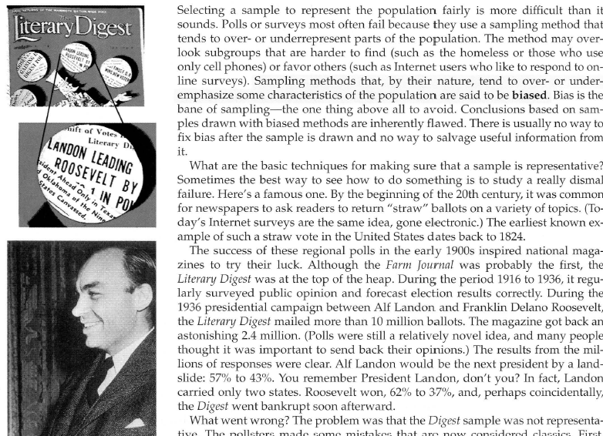

Slide 22
Nonresponse
individuals chosen for the sample can’t be contacted or refuse to cooperate
NOT the same thing as self-selection (voluntary response)
telephone surveys 70% nonresponse

Slide 23
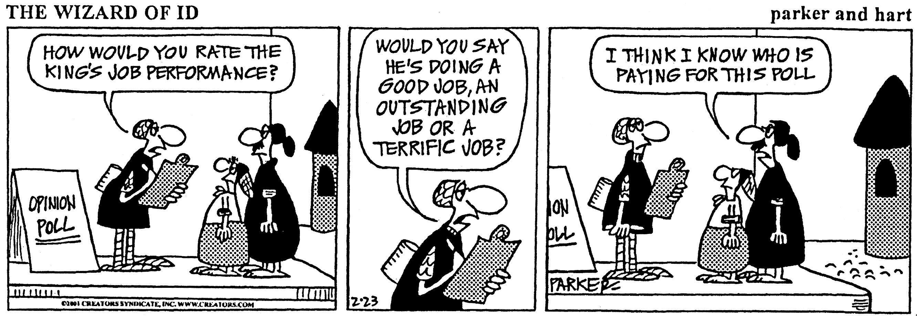
Response Bias
anything in the survey design that influences the responses
Interviewer bias/intimidation
Untruthful responses
The wording of a question

Slide 24
(examples of response bias)
A uniformed campus police office visits your class and asks every student about their drug use in the last 30 days…
In 2011, Leander ISD was forced to cut a number of jobs due to budget cuts. As part of their exit surveys, they asked teachers the following question: “Would you recommend Leander ISD to a friend as a good place to work?”

Slide 25
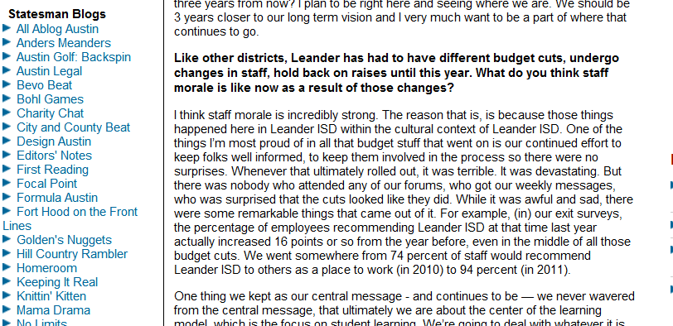
“We went somewhere from 74 percent of staff would recommend Leander ISD to others as a place to work (in 2010) to 94 percent (in 2011).”

Slide 26
Bias through wording of a question

Slide 27
Subtle differences in phrasing can make a big difference
In January 2006, the New York Times asked half of the 1229 U.S. adults in their sample the following question:
After 9/11, President Bush authorized government wiretaps on some phone calls in the U.S. without getting court warrants, saying this was necessary to reduce the threat of terrorism. Do you approve or disapprove of this?
53% of respondents approved.

Slide 28
subtle differences in phrasing can make a big difference!
…but when they asked the other half of their sample a question with only slightly different wording:
After 9/11, George W. Bush authorized government wiretaps on some phone calls in the U.S. without getting court warrants. Do you approve or disapprove of this?
…only 46% approved

Slide 29
subtle differences in phrasing can make a big difference!
After 9/11, President Bush authorized government wiretaps on some phone calls in the U.S. without getting court warrants, saying this was necessary to reduce the threat of terrorism. Do you approve or disapprove of this?
After 9/11, George W. Bush authorized government wiretaps on some phone calls in the U.S. without getting court warrants. Do you approve or disapprove of this?

Slide 30
BIAS through wording of question
Spring, 1993, Holocaust Memorial Museum opened in Washington, DC.
Survey conducted by Roper Starch Worldwide indicated that 22 percent of the American public believed it “possible that the Nazi extermination of the Jews never happened”, while another 12 percent were unsure.

Slide 31
Exact wording of the Roper question:
Does it seem possible, or does it seem impossible to you that the Nazi extermination of the Jews never happened?
Gallup question in a new poll:
Does it seem possible to you that the Nazi extermination of the Jews never happened, or do you feel certain that it happened?
…less than 1% responded that they thought it was possible it did not happen

Slide 32
stop!

