Slide 1
CATEGORICAL DATA CHAPTER 3
GET A CALCULATOR!

Slide 2
CATEGORICAL DATA chapter 3
THE THREE RULES OF DATA ANALYSIS
won’t be difficult to remember:
Make a picture — things may be revealed that are not obvious in the raw data. These will be things to think about.
MAKE A PICTURE — important features of and patterns in the data will show up. You may also see things that you did not expect.
MAKE A PICTURE — the best way to tell others about your data is with a well-chosen picture.

Slide 3
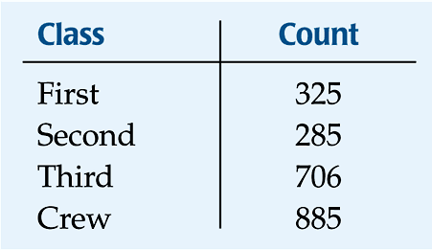
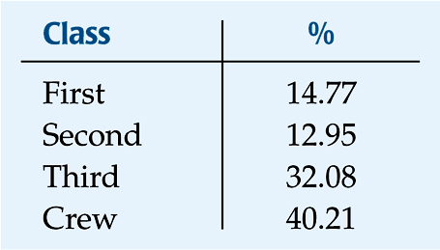
DISTRIBUTION name of categories and how frequently each occurs
Frequency distribution
Relative frequency distribution

Slide 4
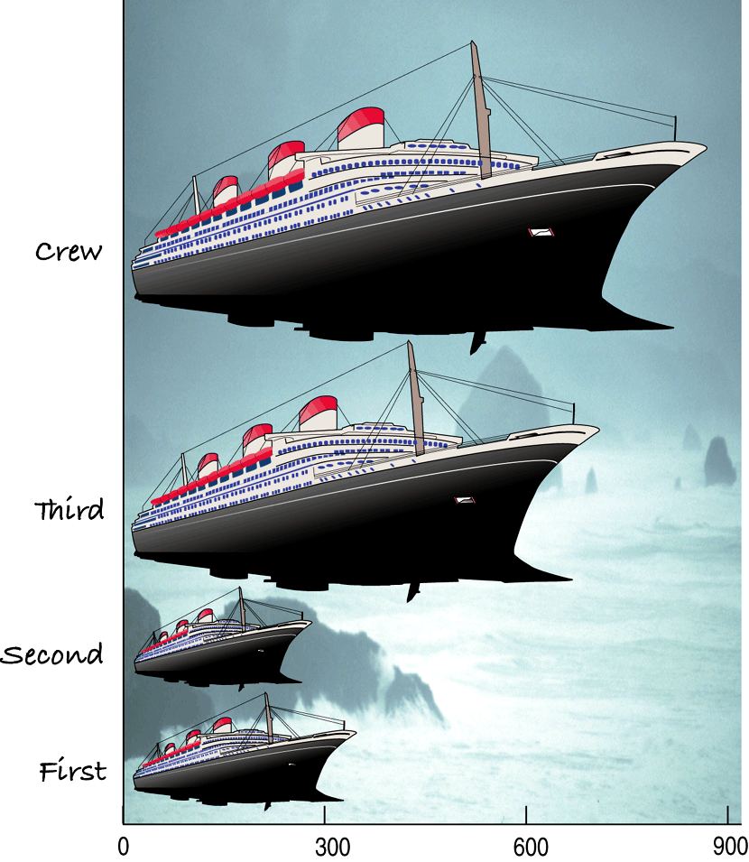
What do you see?
this is a Violation of the “Area Principle”
When we look at each ship, we see the area taken up by the ship, instead of the length of the ship.

Slide 5
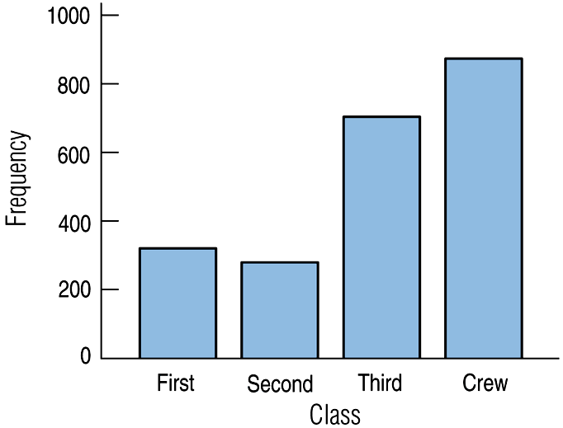
BAR GRAPHS
A bar chart displays the distribution of a categorical variable, showing the counts for each category next to each other for easy comparison.
A bar chart stays true to the area principle.
For bar charts (with categorical data), be sure to leave spaces between the bars!!!

Slide 6
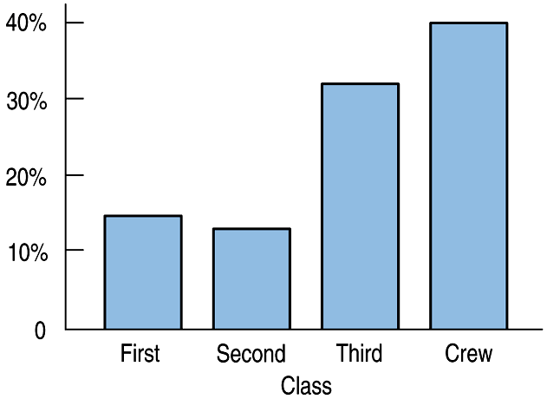
BAR CHARTS
A relative frequency bar graph displays the relative proportion of counts for each category.

Slide 7
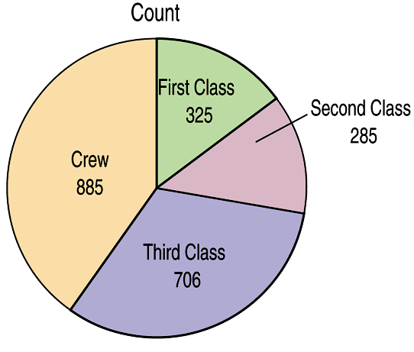
Pie Charts
When you are interested in parts of the whole,
a pie chart might be your display of choice.

Slide 8
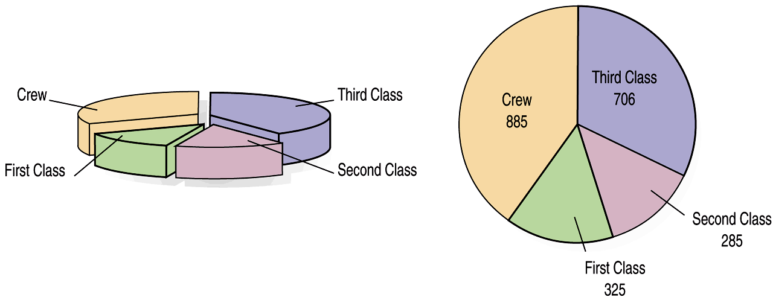
WHAT CAN GO WRONG?
While some people might like the pie chart on the left better, it is harder to compare fractions of the whole, which a well-done pie chart does.

Slide 9
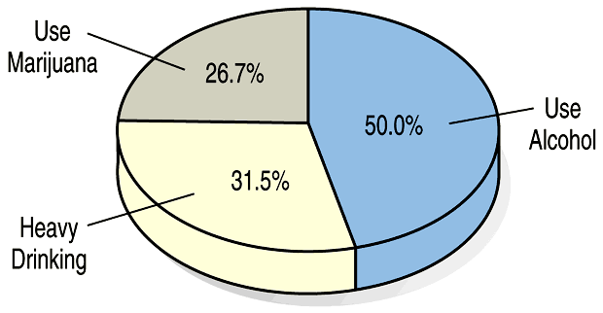
WHAT CAN GO WRONG?
This plot of the percentage of high-school students who engage in specified dangerous behaviors has a problem. Can you see it?

Slide 10
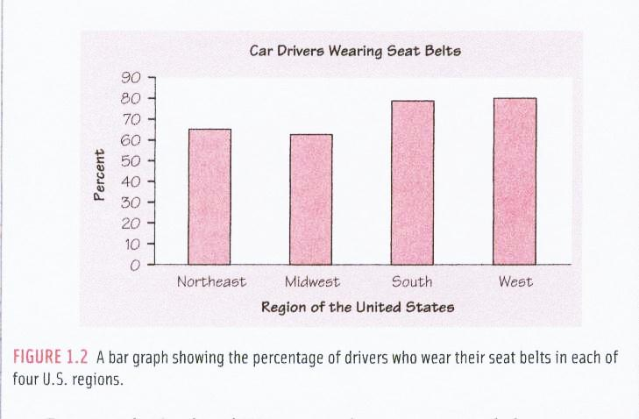
In which region do the greatest NUMBER of people wear seatbelts?

Slide 11
Note: we are using the word “proportion” (or “percentage”)… …NOT the word “number”
Overall, the bar chart shows that all four regions of the country have more than 60% of car drivers wearing seat belts.
The Midwest has the smallest proportion of car drivers wearing seat belts (about 62%) where the South and West have the largest proportion (about 78- 80%).

Slide 12
back to the Titanic…

Slide 13
A 2-WAY TABLE (OR “CONTINGENCY” TABLE) allows us to look at two categorical variables together.
Class
 | First | Second | Third | Crew | Total
Alive | 203 | 118 | 178 | 212 | 711
Dead | 122 | 167 | 528 | 673 | 1490
Total | 325 | 285 | 706 | 885 | 2201
Survival
marginal distributions

Slide 14
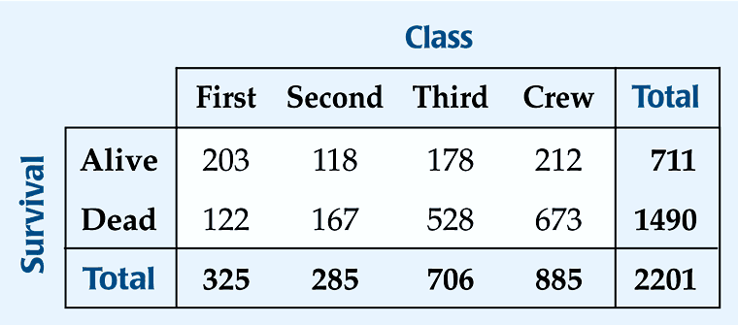
What percent of the people on the Titanic died?
What percent of the people were surviving crew?
*What percent of the survivors were First class?
*What percent of First class survived?
1490/2201 = 67.7%
212/2201 = 9.6%
203/711 = 28.6%
203/325 = 62.5%

Slide 15
CONDITIONAL DISTRIBUTIONS
Separated on the CONDITION of SURVIVAL:

Slide 16
c) Construct a graphical display that shows the association between “class” and “survival”. Write a few sentences describing the association between class and survival status.
To check for an association between
variables, you MUST compare
PROPORTIONS (not COUNTS!!!)

Slide 17
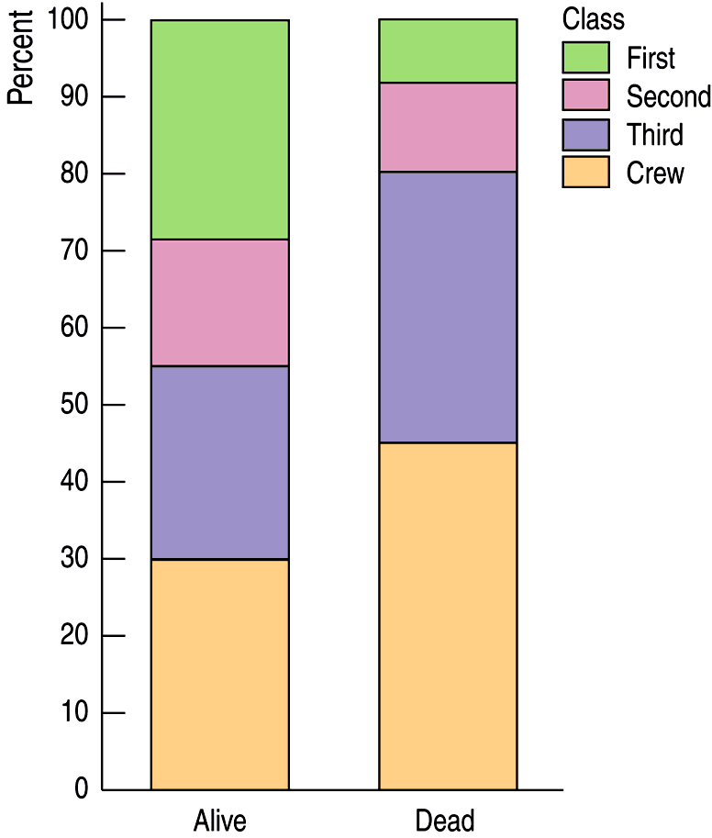
SEGMENTED BAR GRAPH
A segmented bar graph displays the same information as a pie chart, but in the form of bars instead of circles.
Proportion

Slide 18
SEGMENTED BAR GRAPH
A segmented bar graph displays the same information as a pie chart, but in the form of bars instead of circles.
FIRST
FIRST
SECOND
SECOND
THIRD
THIRD
CREW
CREW

Slide 19
SEGMENTED BAR GRAPH
…DESCRIBE THE ASSOCIATION BETWEEN THE TWO VARIABLES:
First class passengers make up a much larger proportion of the “alive” group (about 30%) than the “dead” group (about 8%)
The proportion of 2nd class is slightly greater in the “alive” group than the “dead” group (17% to 11%).
The proportions of “crew” and “third class” are greater in the “dead” group than the “alive” group (crew: 45% to 30%; 3rd: 35% to 25%)
FIRST
FIRST
SECOND
When describing association between categorical variables, you MUST compare
PROPORTIONS (not COUNTS!!!)
SECOND
THIRD
THIRD
CREW
CREW

Slide 20
WHAT IF WE “REVERSE THE AXES”?
YEAH, THAT WORKS TOO.
(IF YOU SEE AN ASSOCIATION ONE WAY, IT’LL SHOW BOTH WAYS)

Slide 21
ANOTHER TYPE OF GRAPH THAT SHOWS ASSOCIATION…
Proportion
(Relative Frequency)

Slide 22
SIDE-BY-SIDE BAR GRAPH (FOR COUNTS)
A graph that compares COUNTS is NO GOOD for displaying association! (especially when the sample sizes are unequal!)
Counts
(Frequency)

Slide 23
LEVEL OF EDUCATION BY GENDER
Level of Education
 | Not High School Graduate | High School Graduate* | College Graduate | Total
Male | 318 29.3% | 603 55.5% | 165 15.2% | 1086 100%
Female | 212 29.3% | 402 55.5% | 110 15.2% | 724 100%
Total | 530 29.3% | 1005 55.5% | 275 15.2% | 1810 100%
Gender
*and not a college graduate

Slide 24
LEVEL OF EDUCATION BY GENDER
A graph that compares COUNTS is no good for displaying association! (especially when the sample sizes are unequal!)

Slide 25
LEVEL OF EDUCATION BY GENDER
College
Graduate
College
Graduate
INDEPENDENT = NO ASSOCIATION
DEPENDENT = ASSOCIATION
 | Not High School Graduate | High School Graduate* | College Graduate | Total
Male | 318 29.3% | 603 55.5% | 165 15.2% | 1086 100%
Female | 212 29.3% | 402 55.5% | 110 15.2% | 724 100%
Total | 530 29.3% | 1005 55.5% | 275 15.2% | 1810 100%
High
School
Graduate
(but not
college
grad)
High
School
Graduate
(but not
college
grad)
GENDER is INDEPENDENT of LEVEL OF EDUCATION (no association)
Not High
School
Graduate
Not High
School
Graduate
Male
Female

Slide 26
STEM PLOTS
A QUICK INTRO TO NUMERICAL DATA…

Slide 27
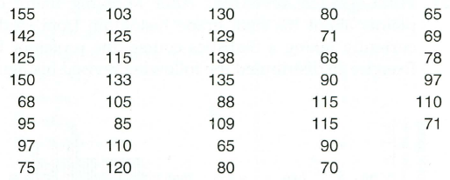
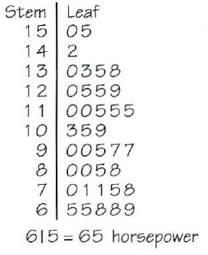
Horsepower of cars reviewed by Consumer Reports:
Each “decade” usually gets its own line…

Slide 28
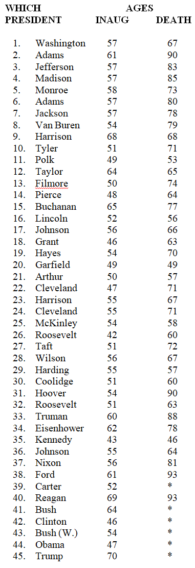
U.S. Presidents – Stem & Leaf Plot
Make a stem & leaf plot of age of…

Slide 29
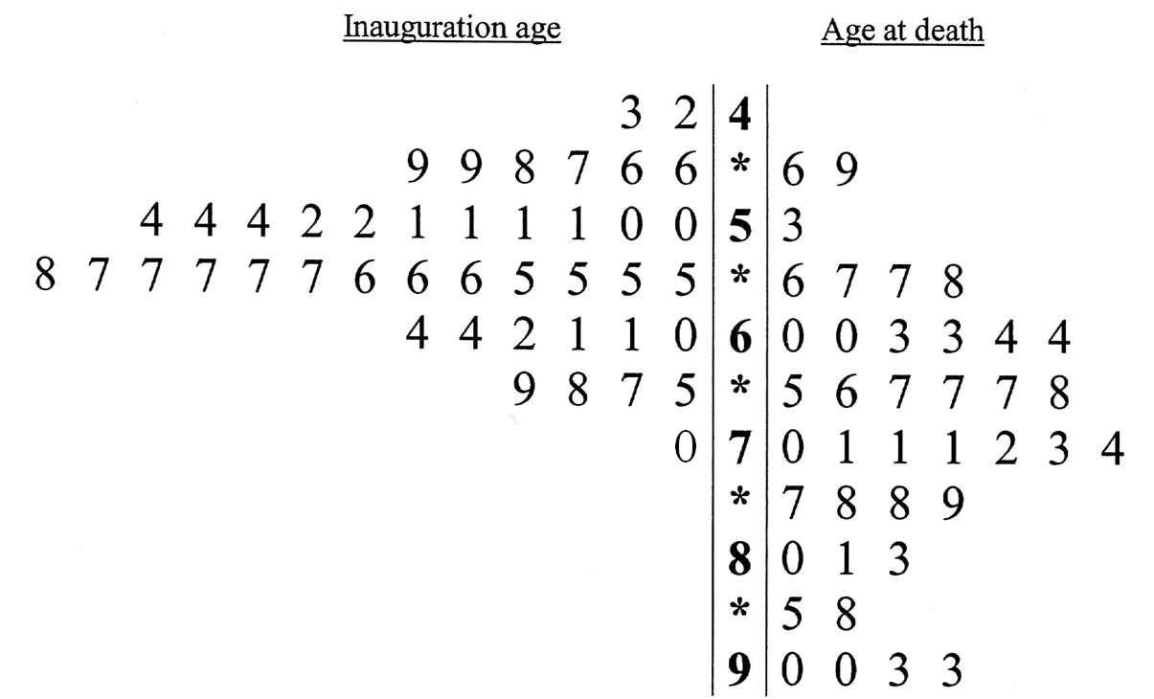
U.S. Presidents
means
age 43 at inauguration
age 46 at death

Slide 30
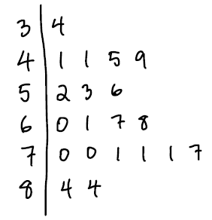
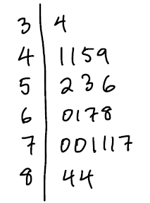
Use stemplots for small to fairly moderate sizes of data (25 – 100)
Try to use graph paper (or make sure that your numbers line up)
(this is okay…)
(this is NOT)

Slide 31
stop!
(measure hair lengths!)

