Slide 1
NUMERICAL DATA
(QUANTITATIVE)
CHAPTER 4

Slide 2
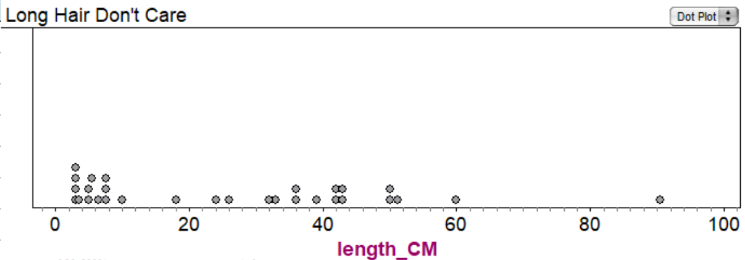
Dotplots
Dot plots work well for relatively small data sets (50ish or fewer)

Slide 3
What’s wrong with this picture?!!
Too much data for a dot plot!
The histogram works much better!

Slide 4
DOTPLOT of test scores

Slide 5

How to read a HISTOGRAM
3 test scores were
≥65 but <70
2 test scores were
≥100 but <105

Slide 6
Changing a histogram’s BIN WIDTH
bin width = 1.0
bin width = 0.5
bin width = 2.0
bin width = 5.0

Slide 7
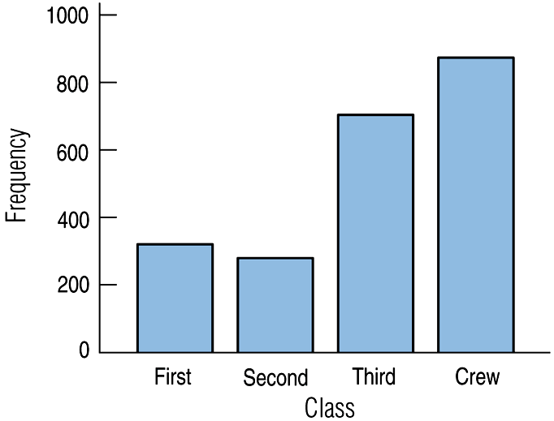
HISTOGRAM vs BAR GRAPHS
HISTOGRAMS
are for NUMERICAL data
BAR GRAPHS are
for CATEGORICAL data

Slide 8
Spread (min & max values
OR IQR OR standard deviation)
CUSS and BS
(describing numerical distributions)
Center (locations of modes OR mean OR median)
Unusual Features (gaps and/or possible outliers)
Shape (unimodal? bimodal? symmetric? skewed? uniform?)
and Be Specific!
(use numerical values when possible)

Slide 9
SHAPE (draw these in) unimodal bimodal uniform

Slide 10
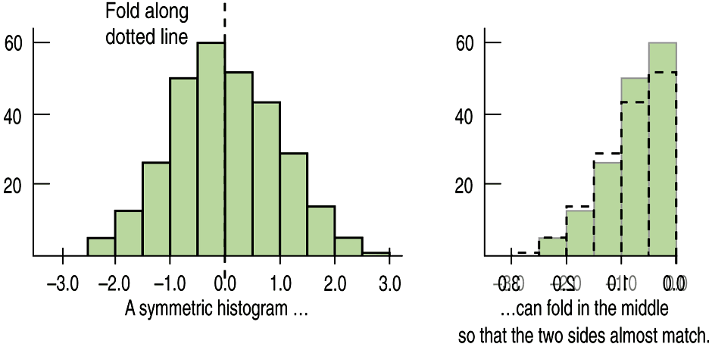
Shape
IF UNIMODAL… what about symmetry?
ALWAYS say “approximately symmetric”
or “roughly symmetric”
(unless it truly is perfectly symmetric)

Slide 11
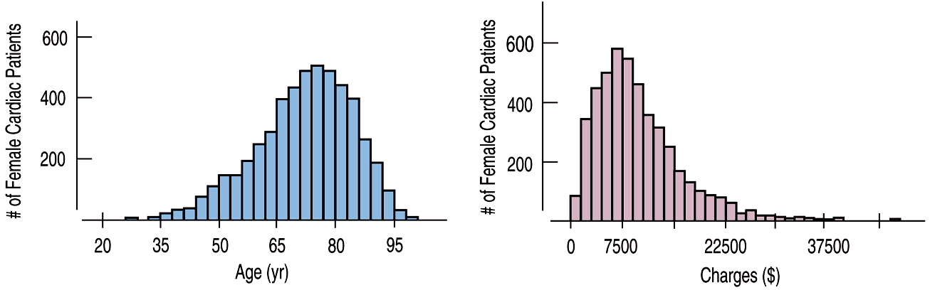
Skewed to the left/right
  The thinner ends of a distribution are called tails.
Skewed to the LEFT
Skewed to the RIGHT
(to the lower “numbers”)
(to the higher “numbers”)

Slide 12
THIS IS THE ONLY SITUATION
IN WHICH YOU ARE ALLOWED
TO USE THE WORD “SKEW”!!!
Skewed to the LEFT
Skewed to the RIGHT
(to the lower “numbers”)
(to the higher “numbers”)

Slide 13
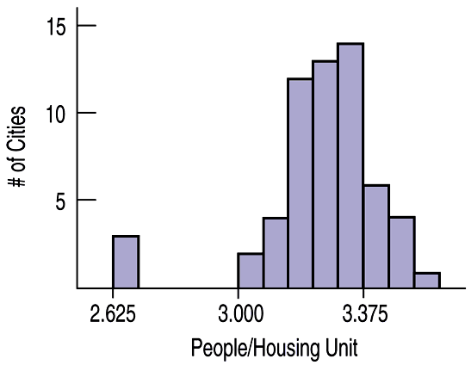
Anything Unusual?
The following histogram has possible outliers—there are three cities in the leftmost bin:
It’s a good idea to say “possible” outliers.
Next time we will learn how to test for outliers.

Slide 14
CENTER
Which one has a higher mode?(draw these in)

Slide 15
CUSS & BS PRACTICE

Slide 16
CUSSing & BS-ing practice
Shape: The shape is bimodal.
Center: This distribution of quiz scores appears to have two modes, one at around 55, and another at around 80.
Spread: The spread is from the mid-30’s to the mid-90’s (range of about 60)
Unusual features: There is a gap in the lower 40’s, with a possible outlier in the mid 30’s.

Slide 17
more CUSSing & BS-ing…
Shape: The shape is unimodal and skewed to the left (to the lower grades)
Center: This distribution of grades has a single mode at around 100.
Spread: The spread is from the mid-50’s to about 100 (range of about 45)
Unusual features: There is a gap from the upper 50’s to the upper 60’s, with a possible outlier in the mid 50’s.
this does NOT mean that someone had a grade of above 100.
(more likely, a lot of 98’s and/or 99’s)

Slide 18
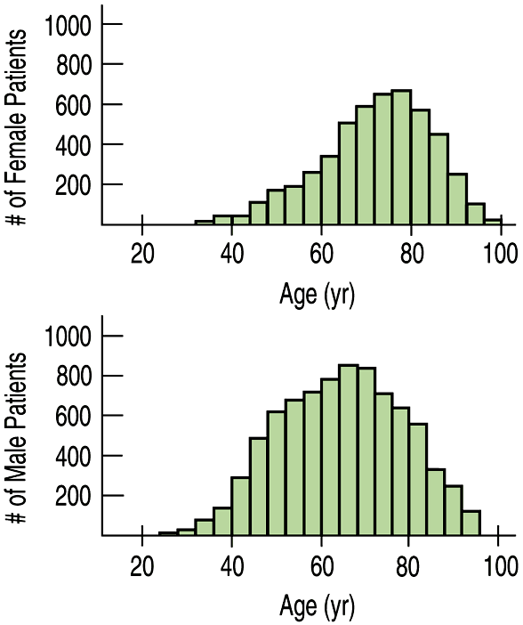
Comparing Distributions
Compare the CENTERS for the following distributions of ages for female and male heart attack patients.
YOU MUST USE COMPLETE SENTENCES!!!

Slide 19
Comparing Distributions
Be sure to use language of comparison.
Center: This distribution of ages for females has a higher center (at around 78) than the distribution for male patients (around 62).
Shape: Both distributions are unimodal. The distribution for males is nearly symmetric, while the distribution for females is slightly skewed to the lower ages.

Slide 20
Comparing Distributions
Spread: Both distributions have similar spreads: females from around 30 – 100, and males from about 24 – 96. Overall, the distribution for female ages is slightly higher than that for male ages.
(There are no unusual features)
YOU MUST USE COMPLETE SENTENCES!!!

Slide 21
US PRESIDENTS STEMPLOTS
(from last time)

Slide 22
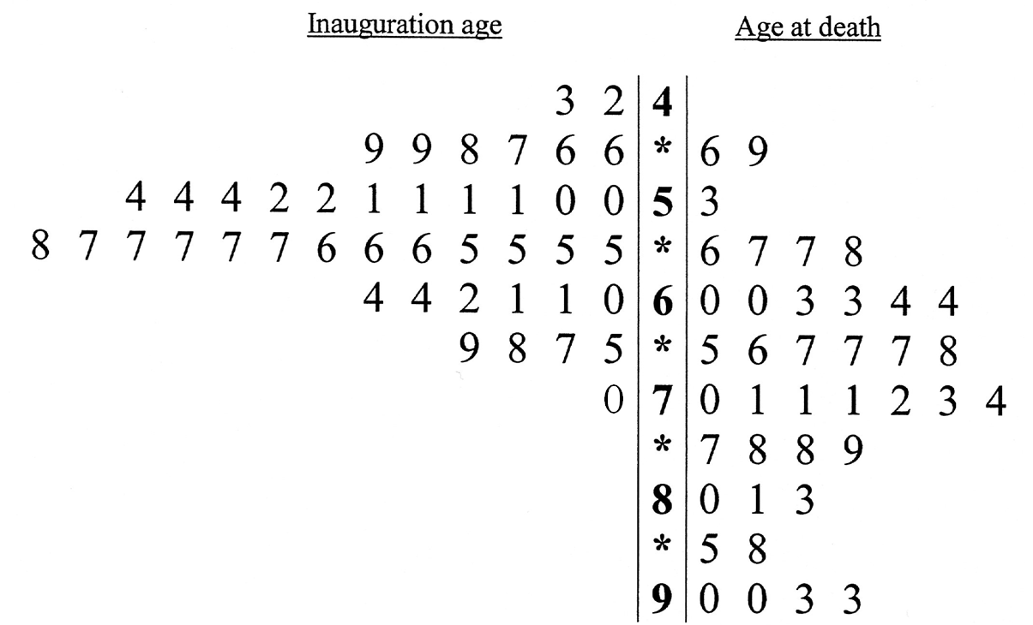
U.S. Presidents
Describe and COMPARE the center and spread for the two distributions of ages.
The distribution of inauguration ages has a MODE in the 50’s…
…while the distribution of ages at death has a MODE in the 60s and early 70’s.
THIS IS NOT ENOUGH TO GET CREDIT FOR A COMPARISON!!!
Thus “death” has a higher mode than “inauguration”.
The “death” distribution has larger spread/variability than “inauguration” (range of 47 versus range of 37).

Slide 23
So… skewed which way?
 |  |  |  |  |  | 9 | 3
 |  |  |  |  |  | 1 | 4 | 2
 |  |  |  |  | 3 | 2 | 5 | 2
 |  |  |  |  | 3 | 0 | 6 | 6 | 8
 |  |  | 7 | 6 | 5 | 5 | 7 | 2 | 4 | 8
 |  | 7 | 3 | 3 | 2 | 1 | 8 | 1 | 4 | 4 | 5 | 5
9 | 9 | 9 | 8 | 4 | 3 | 0 | 9 | 2 | 3 | 6 | 8 | 9 | 9
 |  |  |  |  | 0 | 0 | 10 | 3 | 3 | 4

Slide 24
STOP.

