Slide 1
Outliers…
Leverage…
Influential points…

Slide 2
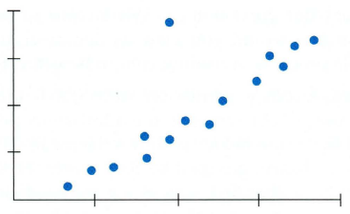
Outlier or Influential point? (or neither?)
Outlier:
- Low leverage
- Weakens “r”
WITHOUT
“outlier”
WITH
“outlier”
(model does not change drastically)

Slide 3
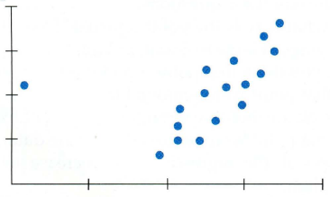
Outlier or Influential point? (or neither?)
Influential Point:
- HIGH leverage
- Weakens “r”
WITHOUT
“outlier”
WITH
“outlier”
(slope changes drastically!)

Slide 4
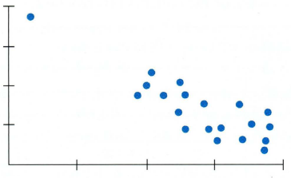
Outlier or Influential point? (or neither?)
- HIGH leverage
- STRENGTHENS “r”
Linear model
WITH and
WITHOUT
“outlier”

Slide 5
Outliers, leverage, and influence
If a point’s x-value is far from the mean of the x-values, it is said to have high leverage. (it has the potential to change the regression line significantly)
A point is considered influential if omitting it gives a very different model.

Slide 6
fin~

